Slide 1
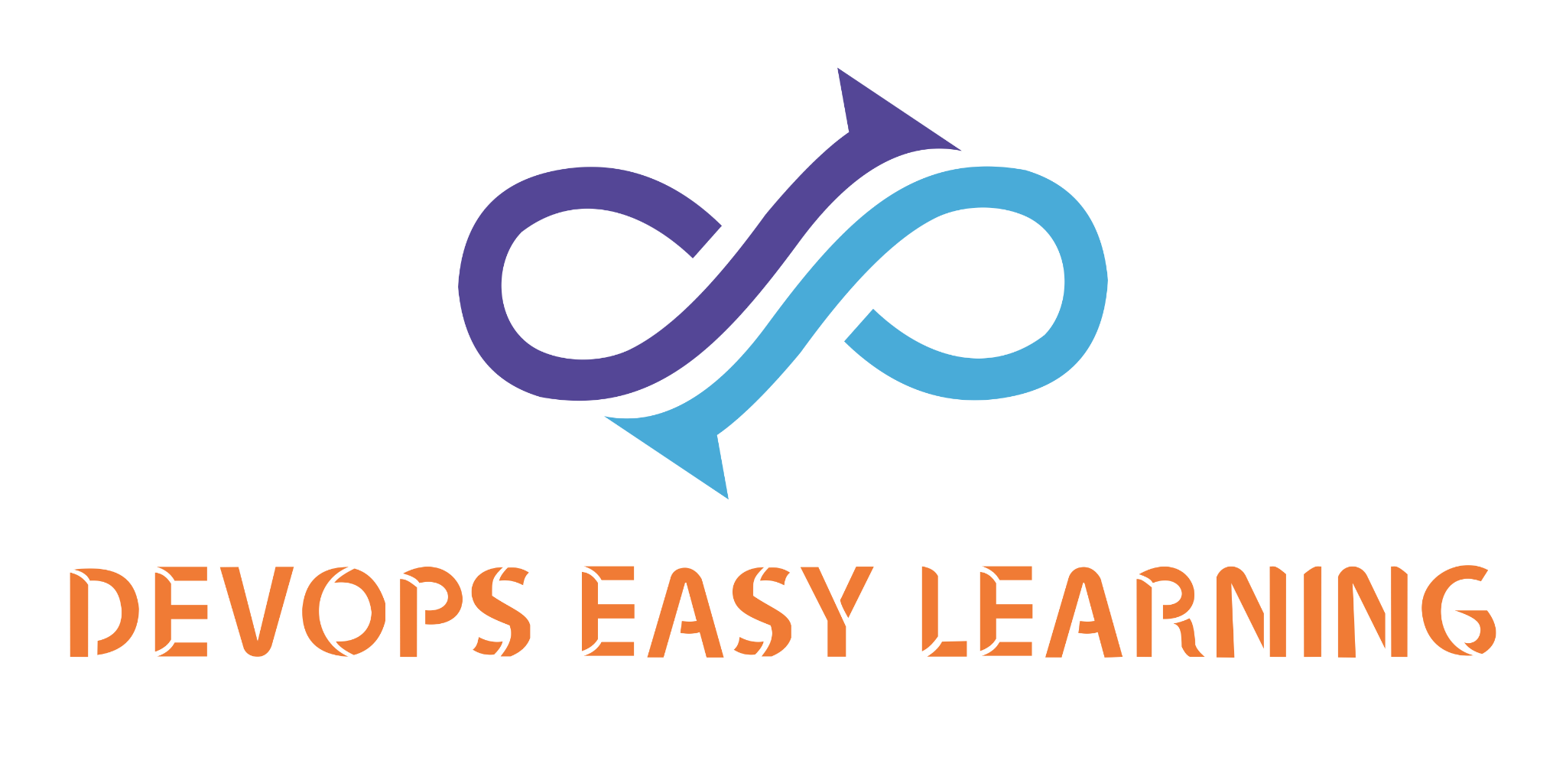
My Kubernetes (K8S) Pocket Cards
https://github.com/devopseasylearning/Kubernetes-code-block/blob/main/all.md

Slide 2
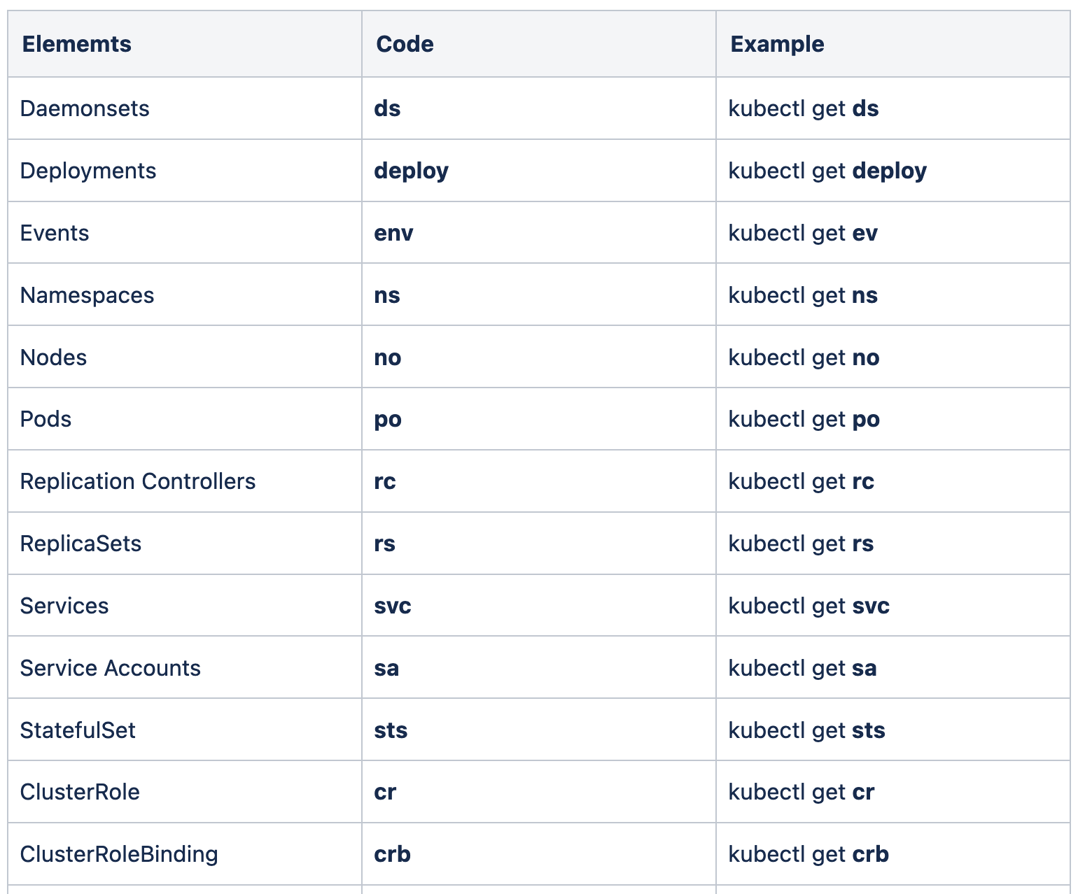
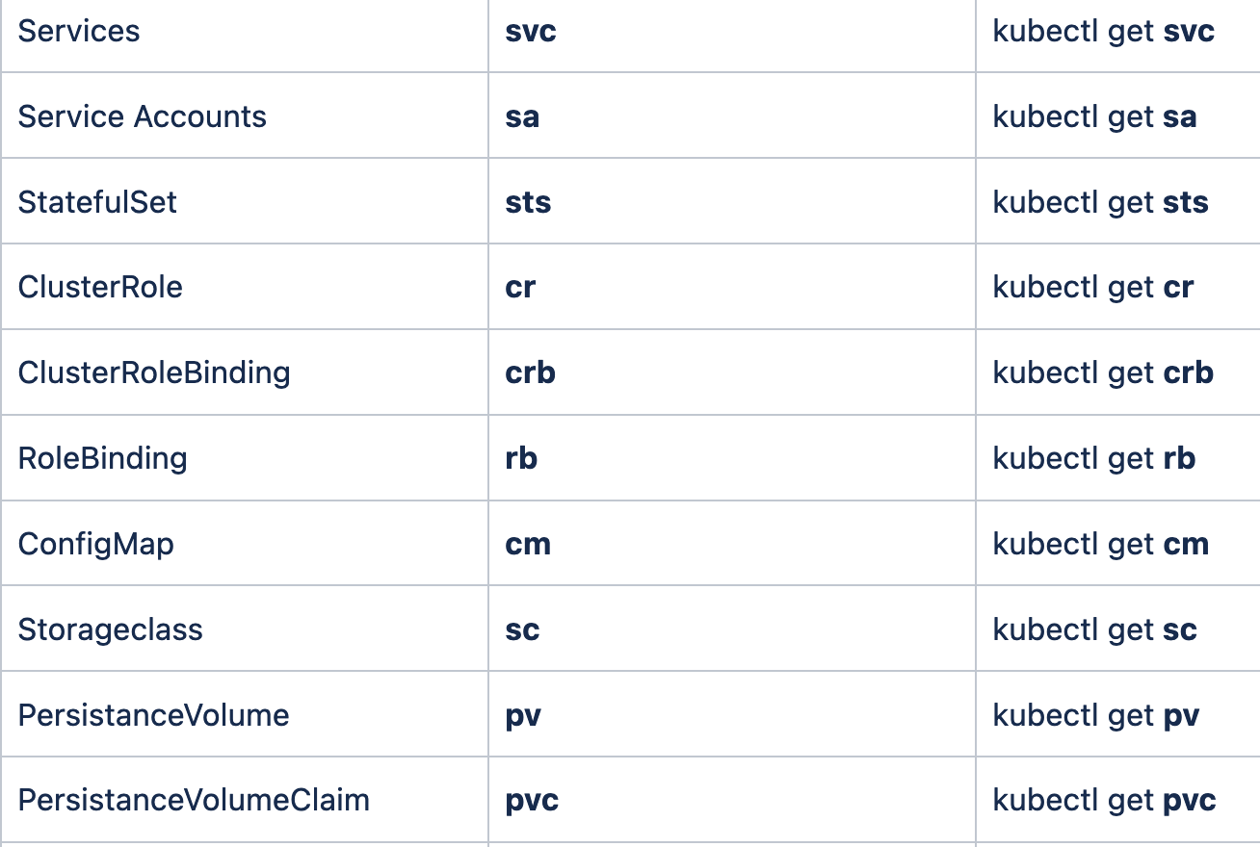
My Kubernetes (K8S) Pocket Cards
Kubernetes Shortcuts

Slide 3
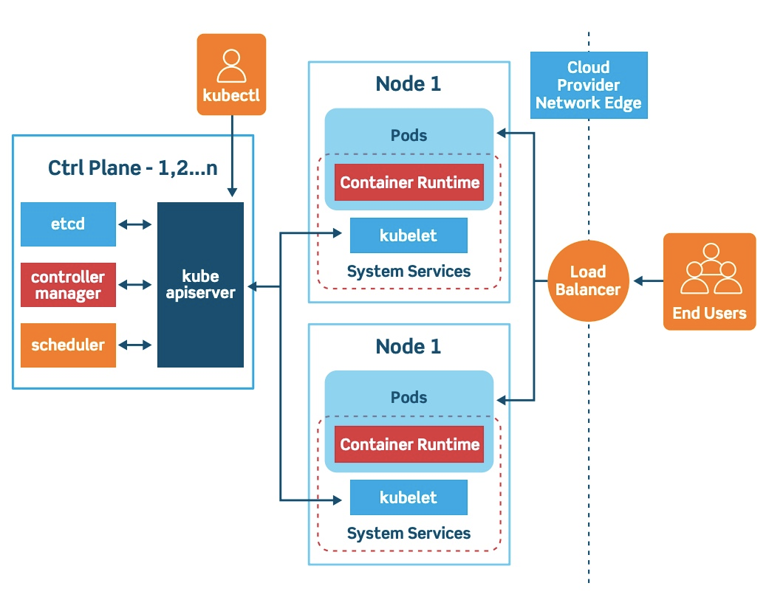
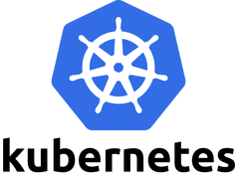
My Kubernetes (K8S) Pocket Cards
What is Kubernetes
Kubernetes, often abbreviated as “K8s”, orchestrates containerized applications to run on a cluster of hosts. The K8s system automates the deployment and management of cloud native applications using on-premises infrastructure or public cloud platforms.
Kubernetes, also known as K8s, is an open-source system for automating deployment, scaling, and management of containerized applications.

Slide 4
My Kubernetes (K8S) Pocket Cards
Automated operations
Kubernetes has built-in commands to handle a lot of the heavy lifting that goes into application management, allowing you to automate day-to-day operations. You can make sure applications are always running the way you intended them to run.
What are the benefits of Kubernetes?
Kubernetes Automates Containerized Environments
Scaling Up and Down
Strong Open Source Communities
Cost Efficiencies and Savings
Ability to Run Anywhere
Multi-Cloud Possibilities
Improve Developer Productivity
Native Tooling Available
Increased Experience and Popularity
Infrastructure abstraction
When you install Kubernetes, it handles the compute, networking, and storage on behalf of your workloads. This allows developers to focus on applications and not worry about the underlying environment.
Service health monitoring
Kubernetes continuously runs health checks against your services, restarting containers that fail, or have stalled, and only making available services to users when it has confirmed they are running.

Slide 5
My Kubernetes (K8S) Pocket Cards
Kubernetes main Components
The control plane manages the worker nodes and the Pods in the cluster. In production environments, the control plane usually runs across multiple computers and a cluster usually runs multiple nodes, providing fault-tolerance and high availability.
A Kubernetes cluster consists of a set of worker machines, called nodes, that run containerized applications. Every cluster has at least one worker node.
The worker node(s) host the Pods that are the components of the application workload.ment.

Slide 6
My Kubernetes (K8S) Pocket Cards
Apiserver
The API server is a component of the Kubernetes control plane that exposes the Kubernetes API. The API server is the front end for the Kubernetes control plane.
The main implementation of a Kubernetes API server is kube-apiserver. kube-apiserver is designed to scale horizontally—that is, it scales by deploying more instances. You can run several instances of kube-apiserver and balance traffic between those instances
Kubernetes Master Components
kube-controller-manager
Control plane component that runs controller processes.
Logically, each controller is a separate process, but to reduce complexity, they are all compiled into a single binary and run in a single process.
Some types of these controllers are:
Node controller: Responsible for noticing and responding when nodes go down.
Job controller: Watches for Job objects that represent one-off tasks, then creates Pods to run those tasks to completion.
Endpoints controller: Populates the Endpoints object (that is, joins Services & Pods).
Service Account & Token controllers: Create default accounts and API access tokens for new namespaces
Etcd
Consistent and highly-available key value store used as Kubernetes' backing store for all cluster data.
If your Kubernetes cluster uses etcd as its backing store, make sure you have a back up plan for those data.
Scheduler
Control plane component that watches for newly created Pods with no assigned node, and selects a node for them to run on.
Factors taken into account for scheduling decisions include: individual and collective resource requirements, hardware/software/policy constraints, affinity and anti-affinity specifications, data locality, inter-workload interference, and deadlines

Slide 7
My Kubernetes (K8S) Pocket Cards
kubelet
An agent that runs on each node in the cluster. It makes sure that containers are running in a Pod.
The kubelet takes a set of PodSpecs that are provided through various mechanisms and ensures that the containers described in those PodSpecs are running and healthy. The kubelet doesn't manage containers which were not created by Kubernetes.
Kubernetes Node Components
kube-proxy kube-proxy is a network proxy that runs on each node in your cluster, implementing part of the Kubernetes Service concept. kube-proxy maintains network rules on nodes. These network rules allow network communication to your Pods from network sessions inside or outside of your cluster. kube-proxy uses the operating system packet filtering layer if there is one and it's available. Otherwise, kube-proxy forwards the traffic itself.
Node components run on every node, maintaining running pods and providing the Kubernetes runtime environment.
Container runtime
The container runtime is the software that is responsible for running containers.

Slide 8
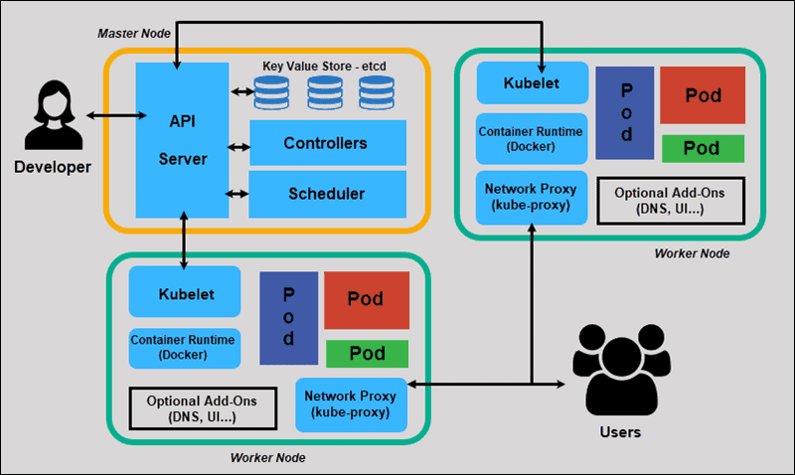
My Kubernetes (K8S) Pocket Cards
Kubernetes Node Components

Slide 9
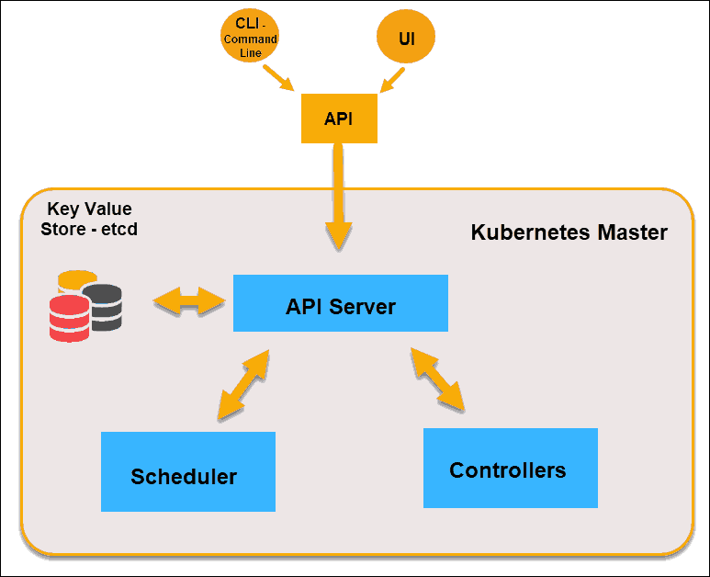
My Kubernetes (K8S) Pocket Cards
Kubernetes Node Components

Slide 10

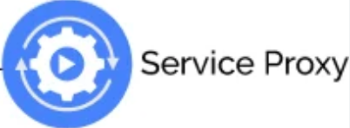

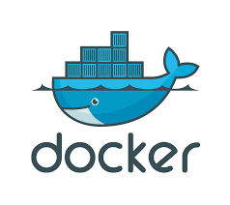
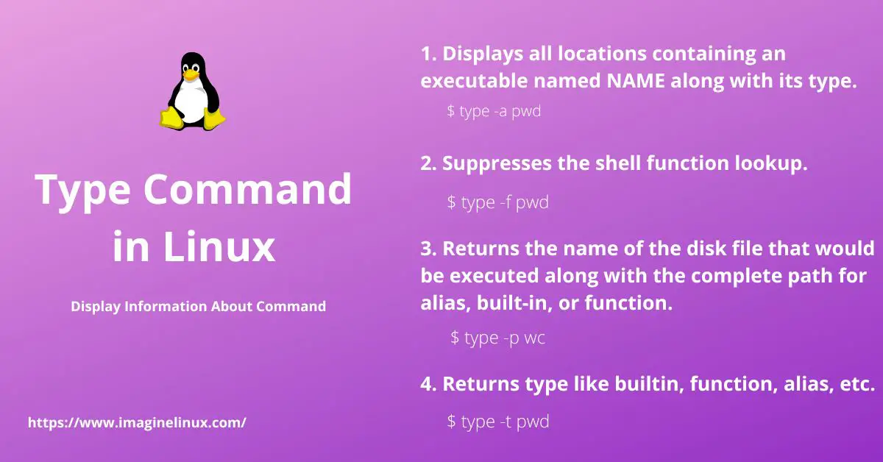

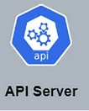
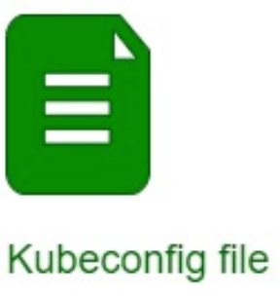

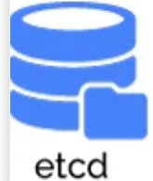

POD CREATION FLOW
3 pods have been created per your request
I want to create 3 pods for my application
13
1a
Running docker command to create 2 pods
Create a pod
1b
Controller manager said Node1,2, &4 are available and healthy
Ok let us create those 3 pod as follow 2 pods on Node1 and 1 pod on Node 4
8
The requested 2 pods has been created
Send request for authentication
7
6
10
User request 3 pods creation
2
3
The requested pod has been created
3 Pods creation stored in database
4
5
12
11
Someone request 3 pods creation what do we have available ?
Node1,2, &4 are available and healthy
9
2 pods created on Node1 and 1 pod on Node 4
Create a pod
Running docker command to create 1 pod

Slide 11
My Kubernetes (K8S) Pocket Cards
One More time
API Server
The API-Server is the front-end of the control plane and the only component in the control plane that we interact with directly. Internal system components, as well as external user components, all communicate via the same API.
etcd
The Key-Value Store, also called etcd, is a database Kubernetes uses to back-up all cluster data. It stores the entire configuration and state of the cluster. The Master node queries etcd to retrieve parameters for the state of the nodes, pods, and containers.
Controller
The role of the Controller is to obtain the desired state from the API Server. It checks the current state of the nodes it is tasked to control, and determines if there are any differences, and resolves them, if any.
Scheduler
A Scheduler watches for new requests coming from the API Server and assigns them to healthy nodes. It ranks the quality of the nodes and deploys pods to the best-suited node. If there are no suitable nodes, the pods are put in a pending state until such a node appears.

Slide 12
Recall
Kubernetes or K8S

Slide 13
Recall
Control plane
Also called “control-plane” for cloud base kubernetes
Cluster
Also called “worker-group or worker node” in for cloud base kubernetes
The control plane controls the cluster

Slide 14

Recall
Administrer K8S
Means your K8S infrastructure is on premise and you are the one that maintain and manage all (master and cluster)
Consume K8S
Means you are using a cloud based K8S and the cloud provider manage the control plane (master) and you manage the cluster

Slide 15
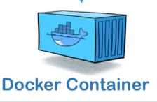
Recall
Controller-manager:
The boss of the cluster it knows everything about the cluster at any given time
Scheduler:
Manage pod scheduling in other word define where the pod should be deployed
Api-server:
The big boss of the entire K8S infrastructure no one can do anything without talking or going thru it not even you as a human being
ETCD:
The database of the the entire K8S infrastructure
Master

Slide 16

What if the scheduler ?
The Kubernetes scheduler is a control plane process which assigns Pods to Nodes. The scheduler determines which Nodes are valid placements for each Pod in the scheduling queue according to constraints and available resources.
So tell me what if the scheduler crash ?

Slide 17
What if the controller manager ?
controller manager are control loops that continuously watch the state of your cluster, then make or request changes.
So tell me what if the controller manager crash ?

Slide 18
What if the etcd
etcd is where Kubernetes stores all of the information about a cluster's state; in fact, it's the only stateful part of the entire Kubernetes control plane.
So tell me what if the etcd crash ?

Slide 19
What if the Api-server
The API (application programming interface) server determines if a request is valid and then processes it. In essence, the API is the interface used to manage, create, and configure Kubernetes clusters. It's how the users, external components, and parts of your cluster all communicate with each other.
So tell me what if the api-server crash ?

Slide 20
Recall
Node
Node
Node
Node
Node
Node
Node
Node
Node
Node
Node
Node
Node
Node
cluster

Slide 21
What if the cluster
A cluster is a set of nodes that run containerized applications.
So tell me what if the entire cluster crash ?

Slide 22
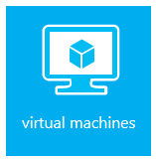

Recall
Node is/are

Slide 23
What if a Node
A Node is a worker machine in Kubernetes and may be either a virtual or a physical machine, depending on the cluster.
So tell me what if a node crash ?

Slide 24
Hey check this out
When a worker node shuts down or crashes, all pods in a StatefulSet that reside on it become unavailable. In these scenarios, the node status is NotReady, and the pod status appears as Unknown or NodeLost or Terminating.

Slide 25
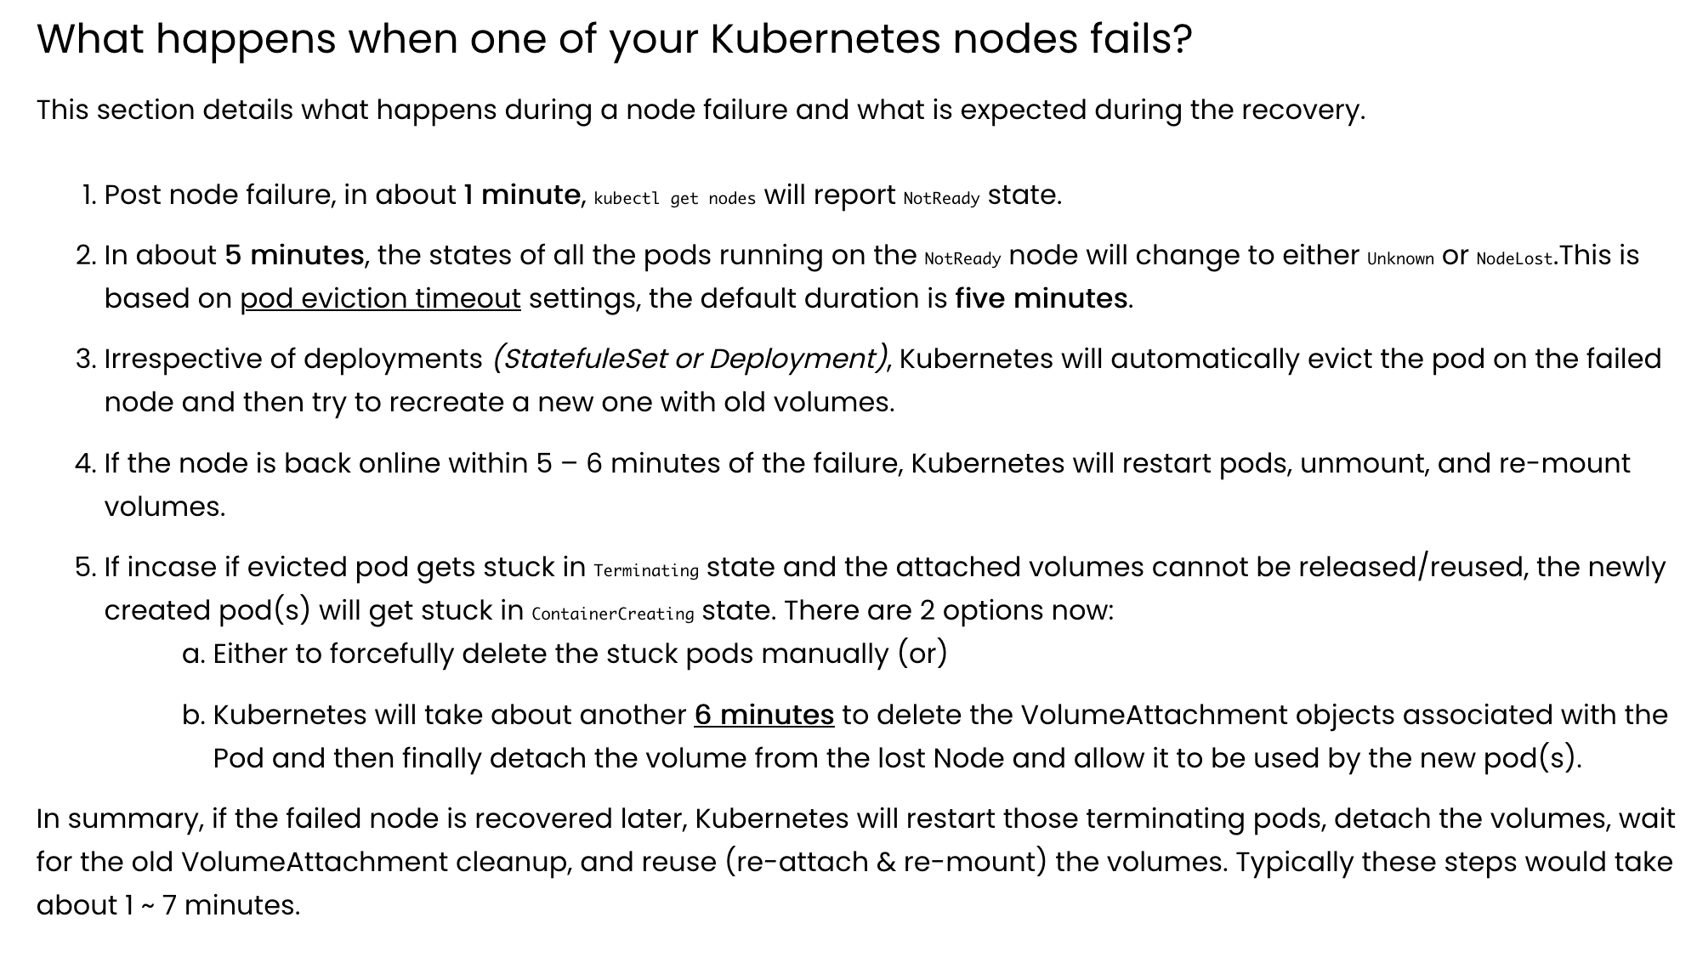
Hey check this out

Slide 26
Recall
Minimum node per cluster 1
Maximum node per cluster 5000

Slide 27

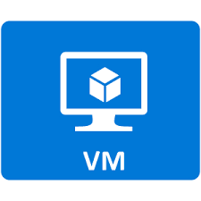
Recall
Kubeproxy:
Manage the entire networking inside the node
Docker:
We need docker on each node to allow containers creation
systemctl start docker
systemctl stop docker
systemctl restart docker
Kubelet:
Run as agent and manage the entire node
systemctl start kubelet
systemctl stop kubelet
systemctl restart kubelet
Node

Slide 28
What if docker
Docker is use to spin containers inside the cluster
So tell me what if docker crash ?

Slide 29
What if kubelet
The kubelet is the primary "node agent" that runs on each node.
So tell me what if kubelet crash ?

Slide 30
What if kube-proxy
kube-proxy is a network proxy that runs on each node in your cluster, implementing part of the Kubernetes Service concept.
So tell me what if kube-proxy crash ?

Slide 31

Recall
Application: the end production expected by the customer
Application(s) are deployed inside container(s)
Container: The environment the application lives inside
container
application

Slide 32

Recall
container(s) leaves inside pod(s)
Pod an envelop or overap around container(s)
container
application
Container: The environment the application lives inside
pod

Slide 33
Recall
good
good
Fair
containers
Not bad but will require lot of maintenance
Pods

Slide 34
Recall
node
Pod(s) leaves inside node(s)
node: an envelop or overap around a virtual machine
container
application
pod
Pod an envelop or overap around container(s)

Slide 35
Recall
node(s) lives inside cluster
container
application
pod
node
cluster
node: an envelop or overap around a virtual machine
cluster an envelop or overap around node(s)

Slide 36
Recall
application lives inside the container
container lives inside the pod
pod lives inside the node
node lives inside the cluster
cluster is controlled and manage by the master

Slide 37
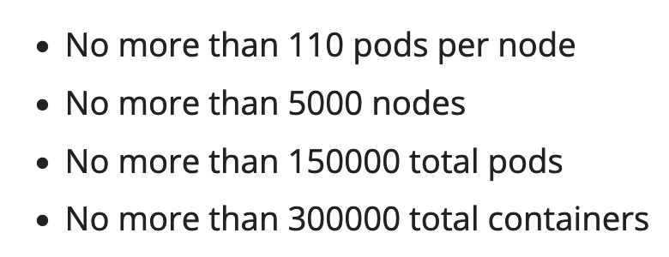
Recall
Be bold but not too bold
Respect limitations

Slide 38
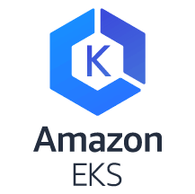
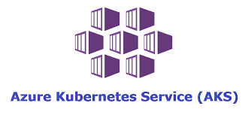
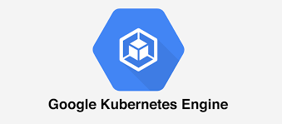
My Kubernetes (K8S) Pocket Cards
Kubernetes Cloud Providers
EKS (Elastic Kubernetes service)
Managed by AWS
GKE (Google Kubernetes Engine)
Managed by Google cloud platform
AKS (Azure Kubernetes Service)
Manage by Azure

Slide 39
My Kubernetes (K8S) Pocket Cards
Kubernetes Shortcuts

Slide 40
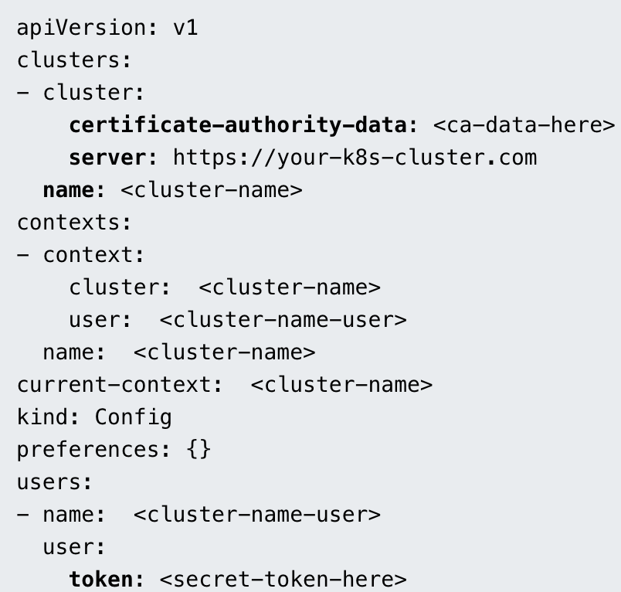
My Kubernetes (K8S) Pocket Cards
A Kubeconfig is a YAML file with all the Kubernetes cluster details, certificate, and secret token to authenticate the cluster.
Kubeconfig
A kubeconfig file is a file used to configure access to Kubernetes when used in conjunction with the kubectl command line tool (or other clients).
A file that is used to configure access to Kubernetes clusters is conventionally referred to as the kubeconfig file.
When you use kubectl, it uses the information in the kubeconfig file to connect to the kubernetes cluster API. The default location of the Kubeconfig file is $HOME/.kube/config
There is a kubeconfig file behind every working kubectl command. This file typically lives at $HOME/.kube/config

Slide 41
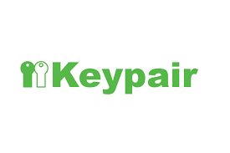
My Kubernetes (K8S) Pocket Cards
Keypair
devops=money
key
value
When something=something it forms a keypair

Slide 42
My Kubernetes (K8S) Pocket Cards
How do we deal with non sensitive data in K8S ?
Hello guys welcome to K8S ConfigMap

Slide 43
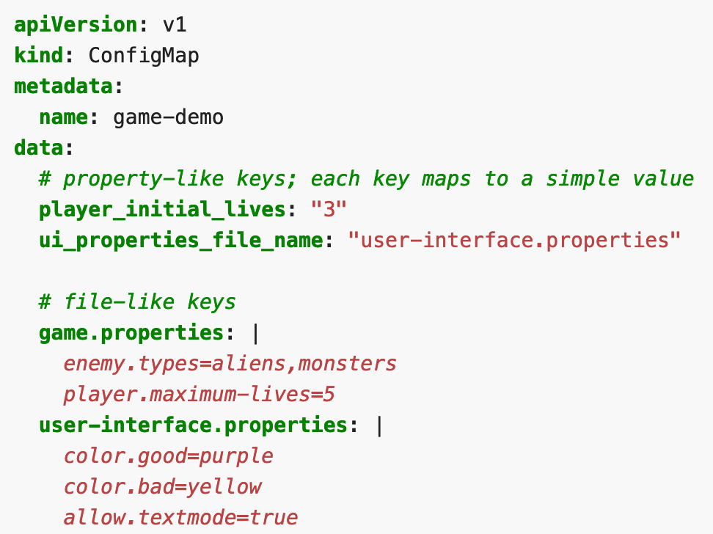
My Kubernetes (K8S) Pocket Cards
ConfigMap (cm)
$ kubectl get cm
ConfigMaps
A ConfigMap is an API object used to store non-confidential data in key-value pairs. Pods can consume ConfigMaps as environment variables, command-line arguments, or as configuration files in a volume.
A ConfigMap allows you to decouple environment-specific configuration from your container image , so that your applications are easily portable.
In simple terms, a ConfigMap is a Kubernetes API object that allows you to store non-sensitive information.

Slide 44
My Kubernetes (K8S) Pocket Cards
ConfigMap (cm)
$ kubectl get cm
ConfigMap is a Kubernetes API object that allows you to store non-sensitive information in form of keypair

Slide 45
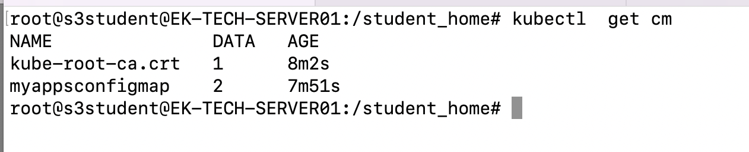
My Kubernetes (K8S) Pocket Cards
Pay attention these are upper case
Make it easy use this instead
ConfigMap (cm)
This how you list cm

Slide 46
My Kubernetes (K8S) Pocket Cards
How do we deal with sensitive data in K8S ?
Hello guys welcome to K8S Secret

Slide 47
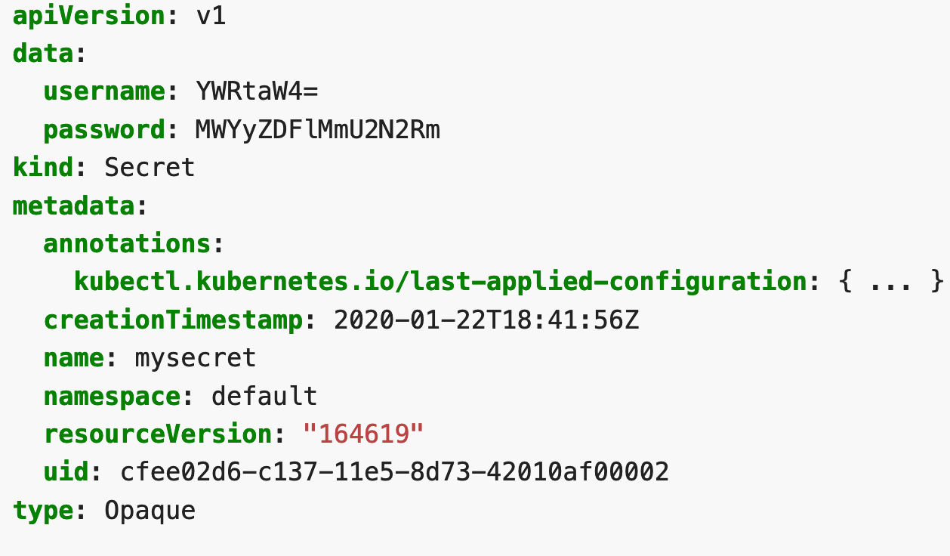
My Kubernetes (K8S) Pocket Cards
A Kubernetes secret is an object storing sensitive pieces of data such as usernames, passwords, tokens, and keys. Secrets are created by the system during an app installation or by users whenever they need to store sensitive information and make it available to a pod.
If passwords, tokens, or keys were simply part of a pod definition or container image, they could be accidentally exposed during Kubernetes operations. Therefore, the most important function of the secret is to prevent accidental exposure of the information stored in it while at the same time making it available wherever the user needs it.
Secret
Secrets
A Secret is an object that contains a small amount of sensitive data such as a password, a token, or a key
$ kubectl get secret

Slide 48

My Kubernetes (K8S) Pocket Cards
Secret
$ kubectl get secret
secret is a Kubernetes API object that allows you to store sensitive information in form of keypair and base64 encode

Slide 49
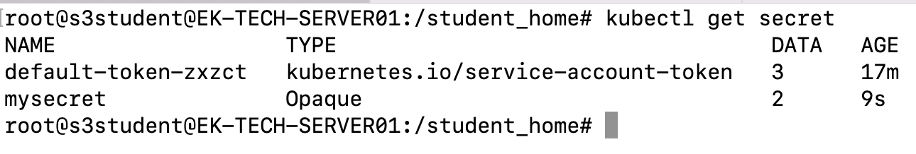
My Kubernetes (K8S) Pocket Cards
This how you list secret

Slide 50
My Kubernetes (K8S) Pocket Cards
ConfigMap vs Secret
Both, ConfigMaps and Secrets store data as a key value pair. The major difference is, Secrets store data in base64 format meanwhile ConfigMaps store data in a plain text.
If you have some critical data like, keys, passwords, service accounts credentials, db connection string, etc then you should always go for Secrets rather than Configs.
And if you want to do some application configuration using environment variables which you don't want to keep secret/hidden like, app theme, base platform url, etc then you can go for ConfigMaps
Both ConfigMaps and secrets store the data the same way, with key/value pairs, but ConfigMaps are meant for plain text data, and secrets are meant for data that you don't want anything or anyone to know about except the application.
Use Secrets for things which are actually secret like API keys, credentials, etc
Use ConfigMaps for not-secret configuration data

Slide 51
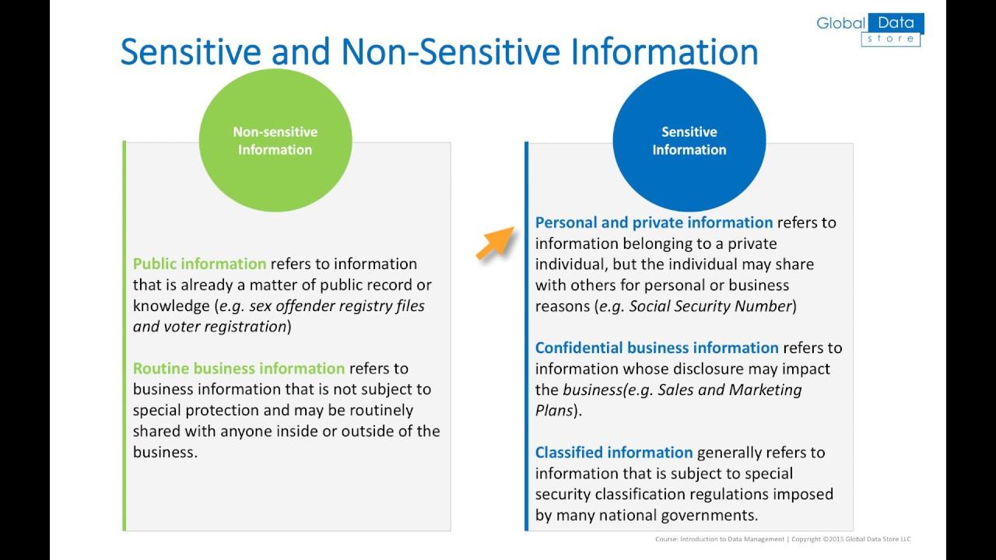
My Kubernetes (K8S) Pocket Cards
ConfigMap vs Secret
Both, ConfigMaps and Secrets store data as a key value pair. The major difference is, Secrets store data in base64 format meanwhile ConfigMaps store data in a plain text.
If you have some critical data like, keys, passwords, service accounts credentials, db connection string, etc then you should always go for Secrets rather than Configs.
And if you want to do some application configuration using environment variables which you don't want to keep secret/hidden like, app theme, base platform url, etc then you can go for ConfigMaps
Both ConfigMaps and secrets store the data the same way, with key/value pairs, but ConfigMaps are meant for plain text data, and secrets are meant for data that you don't want anything or anyone to know about except the application.
Use Secrets for things which are actually secret like API keys, credentials, etc
Use ConfigMaps for not-secret configuration data

Slide 52
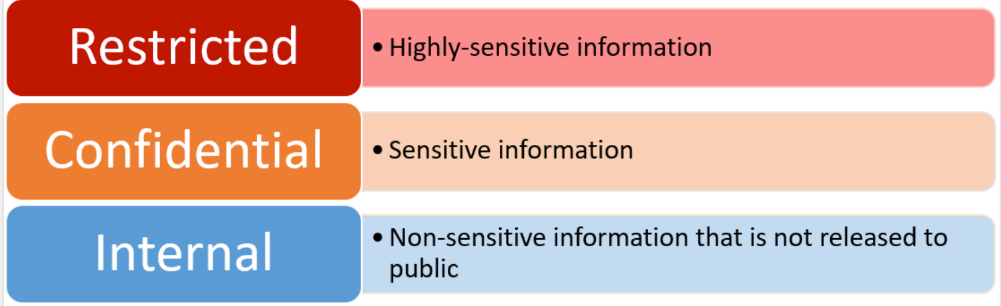
My Kubernetes (K8S) Pocket Cards
ConfigMap vs Secret
secret is a Kubernetes API object that allows you to store sensitive information in form of keypair and base64 encode
ConfigMap is a Kubernetes API object that allows you to store non-sensitive information in form of keypair

Slide 53
My Kubernetes (K8S) Pocket Cards
How do we make sure a pod is deployed on every single node at the same time in K8S ?
Hello guys welcome to K8S Daemonset

Slide 54
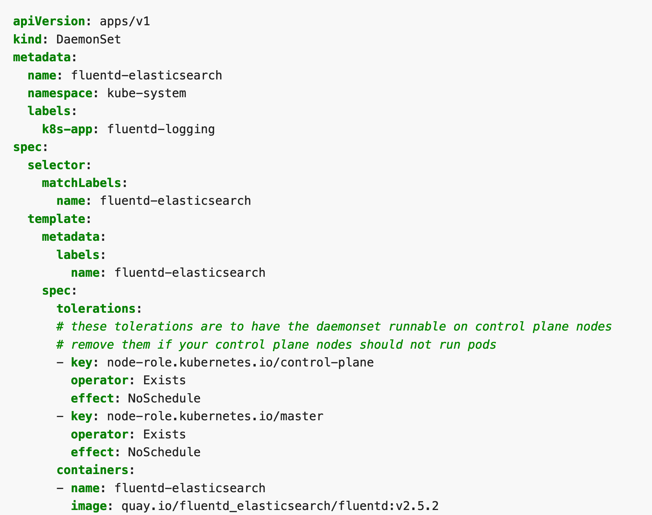
My Kubernetes (K8S) Pocket Cards
DaemonSet
A DaemonSet ensures that all (or some) Nodes run a copy of a Pod. As nodes are added to the cluster, Pods are added to them. As nodes are removed from the cluster, those Pods are garbage collected. Deleting a DaemonSet will clean up the Pods it created.
Some typical uses of a DaemonSet are:
running a cluster storage daemon on every node
running a logs collection daemon on every node
running a node monitoring daemon on every node
Daemonset
$ kubectl get ds

Slide 55
My Kubernetes (K8S) Pocket Cards
Daemonset
$ kubectl get ds
A DaemonSet ensures that all Nodes run a copy of a Pod.

Slide 56
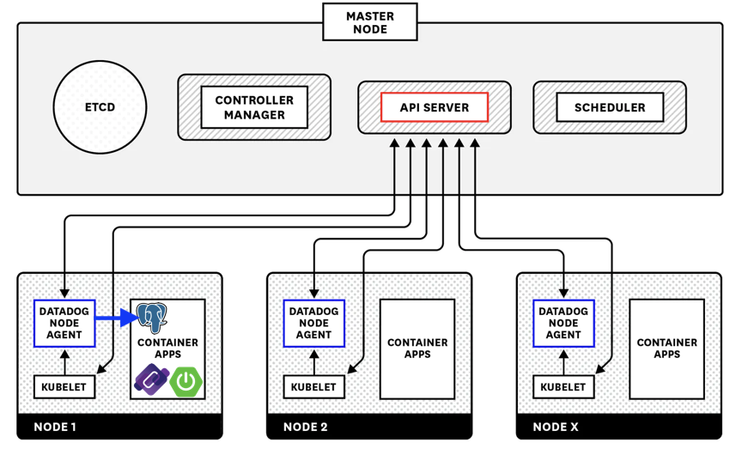
My Kubernetes (K8S) Pocket Cards
DaemonSet
DaemonSet

Slide 57
My Kubernetes (K8S) Pocket Cards
How do we manage tasks in K8S ?
Hello guys welcome to K8S Job

Slide 58
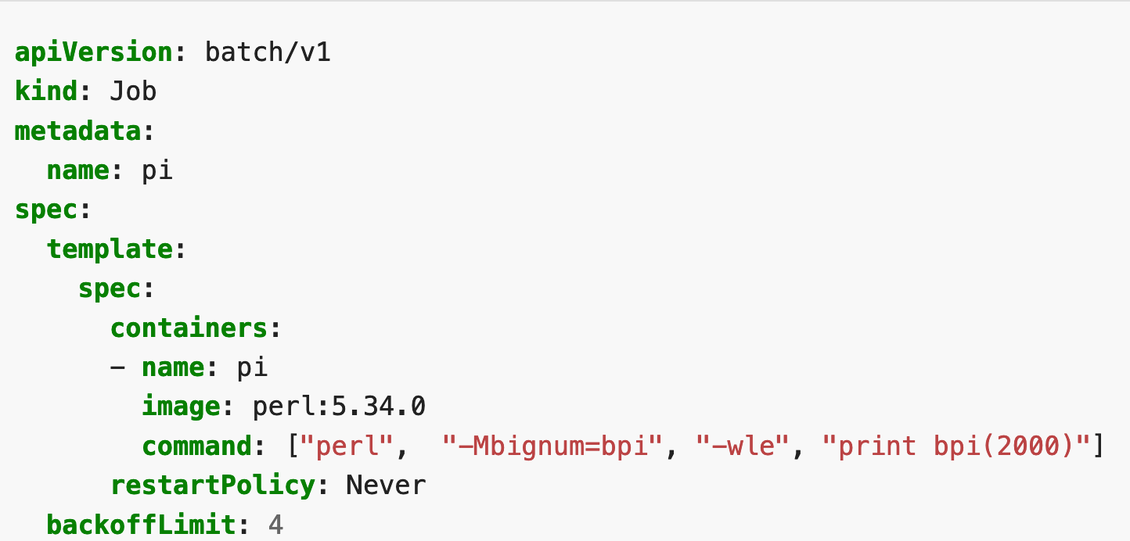
My Kubernetes (K8S) Pocket Cards
Jobs play a major role in K8s and help you to perform tasks within your application
Jobs
The main difference between a Run to completion Job and a Cron Job is
a Run to completion Job will perform a given task and once it’s completed it will stop the process and the Job runs only when we need it to run.
Cron Job also does the same thing but we can schedule a Cron Job to run at a given schedule. For instance, we can schedule a Cron Job to run once every hour or we can schedule it to run at 6 am daily.
There two type of jobs
Run to completion job (also called job)
Cron Job
$ kubectl get jobs
Jobs and Cron Jobs are very important parts of Kubernetes workloads. These Jobs help us to perform a particular task which we assigned to them.

Slide 59
My Kubernetes (K8S) Pocket Cards
job
$ kubectl get job
Job are k8s object that allow to perform tasks within your application

Slide 60
My Kubernetes (K8S) Pocket Cards
Job
$ kubectl get job
cronjob are k8s object that allow to perform tasks within your application at a periodically and at a specific interval on time
For instance, we can schedule a Cron Job to run once every hour or we can schedule it to run at 6 am daily
a Run to completion Job will perform a given task and once it’s completed it will stop the process and the Job runs only when we need it to run.

Slide 61
My Kubernetes (K8S) Pocket Cards
How do we guaranty pod High Availability (HA) or make sure a specific number of pod is/are kept at any given point of time in K8S ?
Hello guys welcome to K8S ReplicaSet

Slide 62
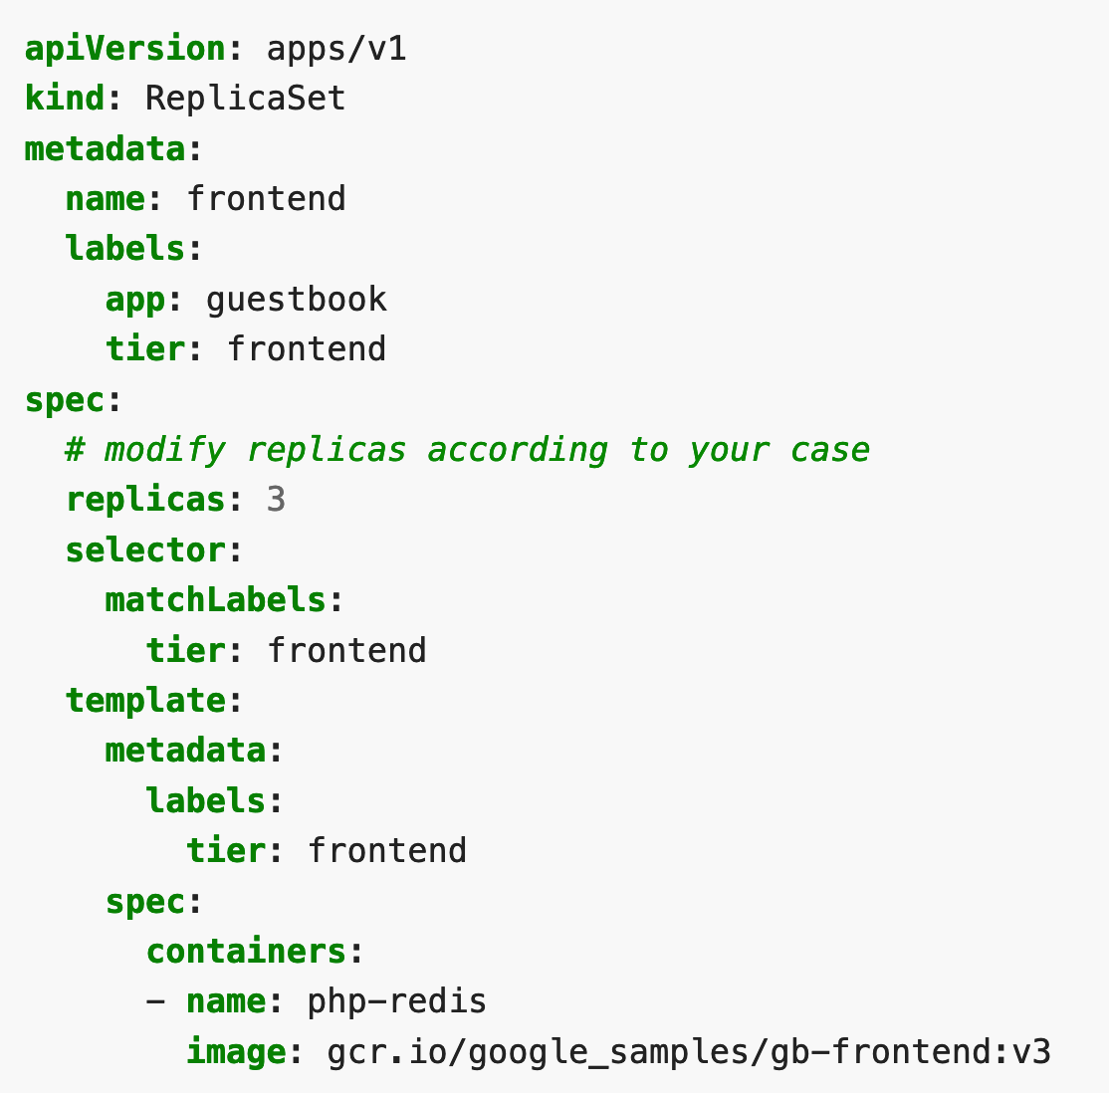
My Kubernetes (K8S) Pocket Cards
ReplicaSet
A ReplicaSet purpose is to maintain a stable set of replica Pods running at any given time. As such, it is often used to guarantee the availability of a specified number of identical Pods.
$ kubectl get rs
A ReplicaSet is a process that runs multiple instances of a Pod and keeps the specified number of Pods constant. Its purpose is to maintain the specified number of Pod instances running in a cluster at any given time to prevent users from losing access to their application when a Pod fails or is inaccessible.
ReplicaSet helps bring up a new instance of a Pod when the existing one fails, scale it up when the running instances are not up to the specified number, and scale down or delete Pods if another instance with the same label is created. A ReplicaSet ensures that a specified number of Pod replicas are running continuously and helps with load-balancing in case of an increase in resource usage.

Slide 63
My Kubernetes (K8S) Pocket Cards
ReplicaSet
$ kubectl get rs
ReplicaSet purpose is to maintain a stable set of replica Pods running at any given time. As such, it is often used to guarantee the availability of a specified number of identical Pods.

Slide 64
My Kubernetes (K8S) Pocket Cards
How do we expose applications on the browser in K8S ?
Hello guys welcome to K8S Service

Slide 65
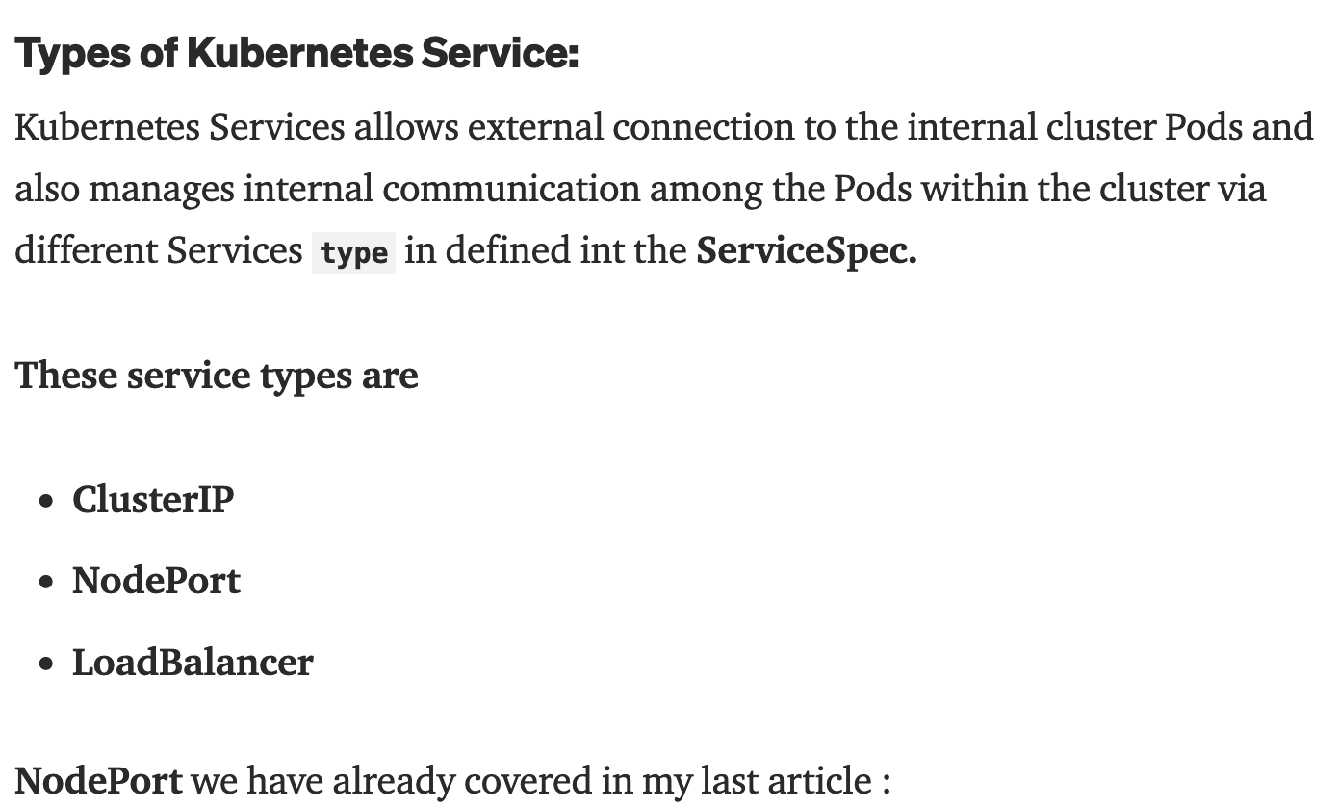
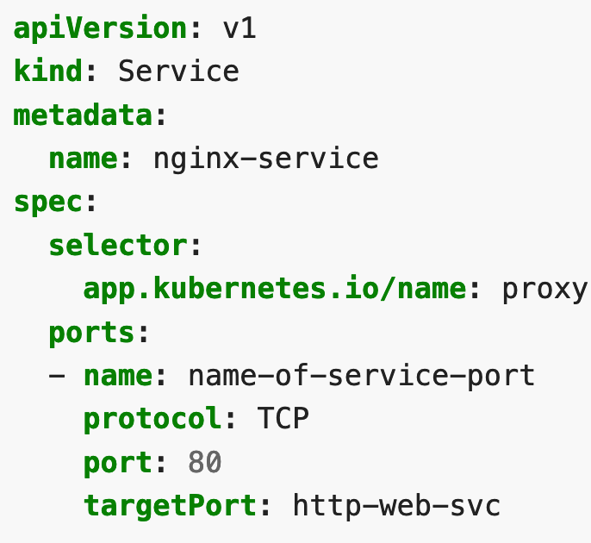
My Kubernetes (K8S) Pocket Cards
Service.
An abstract way to expose an application running on a set of Pods as a network service.
Service
$ kubectl get svc
Service
Make application visible on the browser.

Slide 66
My Kubernetes (K8S) Pocket Cards
Service
$ kubectl get svc
Service
Make application visible on the browser.

Slide 67
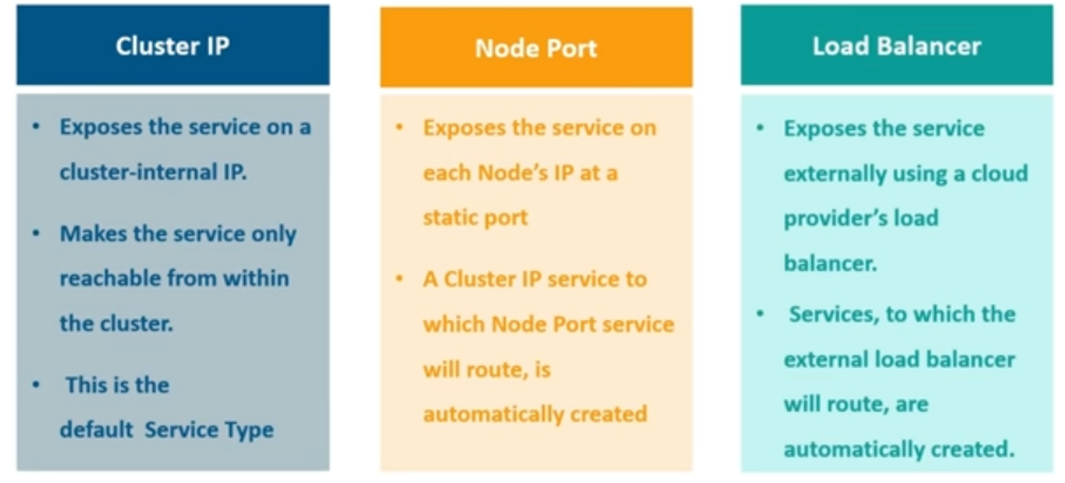
My Kubernetes (K8S) Pocket Cards
Service
$ kubectl get svc

Slide 68


My Kubernetes (K8S) Pocket Cards
How do we expose applications ONLY inside our cluster (not accessible externally on the browser) in K8S ?
Hello guys welcome to K8S Service: ClusterIP

Slide 69
My Kubernetes (K8S) Pocket Cards
Service: ClusterIP
$ kubectl get svc
A ClusterIP service is the default Kubernetes service. It gives you a service inside your cluster that other apps inside your cluster can access. There is no external access.

Slide 70

My Kubernetes (K8S) Pocket Cards
How do we expose applications on every single node (accessible with node IP address and port) in K8S ?
Hello guys welcome to K8S Service: NodePort

Slide 71
My Kubernetes (K8S) Pocket Cards
Service: NodePort
$ kubectl get svc
NodePort
A NodePort service is the most primitive way to get external traffic directly to your service. NodePort, as the name implies, opens a specific port on all the Nodes (the VMs), and any traffic that is sent to this port is forwarded to the service.

Slide 72
My Kubernetes (K8S) Pocket Cards
How do we expose applications using cloud provide DNS (Domain Name Service) in K8S ?
Hello guys welcome to K8S Service: LoadBalancer

Slide 73
My Kubernetes (K8S) Pocket Cards
Service: LoadBalancer
$ kubectl get svc
LoadBalancer type provides a Public IP address or DNS name to which the external users can connect.

Slide 74
My Kubernetes (K8S) Pocket Cards
Service
$ kubectl get svc
A ClusterIP service is the default Kubernetes service. It gives you a service inside your cluster that other apps inside your cluster can access. There is no external access.
LoadBalancer type provides a Public IP address or DNS name to which the external users can connect.
NodePort
A NodePort service is the most primitive way to get external traffic directly to your service. NodePort, as the name implies, opens a specific port on all the Nodes (the VMs), and any traffic that is sent to this port is forwarded to the service.

Slide 75
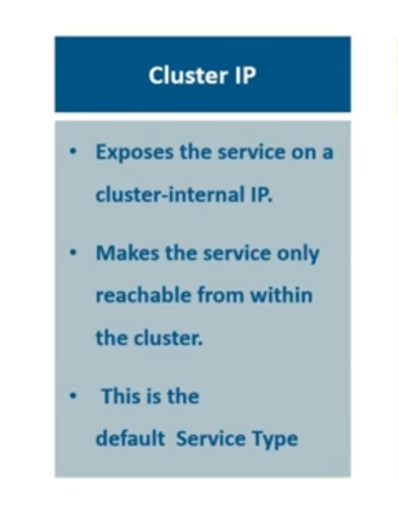
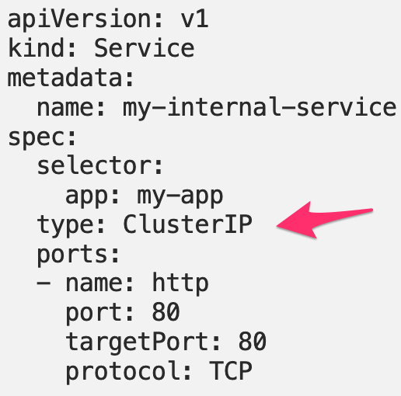
My Kubernetes (K8S) Pocket Cards
Service - ClusterIP
ClusterIP : Exposes the Service on a cluster-internal IP. Choosing this value makes the Service only reac
$ kubectl get svc
clusterIP to connect frond end and backend pod
ClusterIP
A ClusterIP service is the default Kubernetes service. It gives you a service inside your cluster that other apps inside your cluster can access. There is no external access.

Slide 76
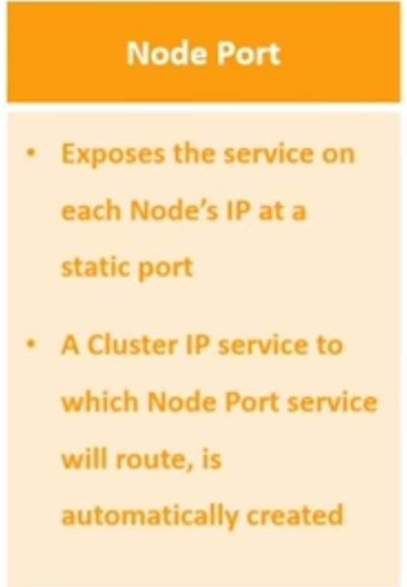
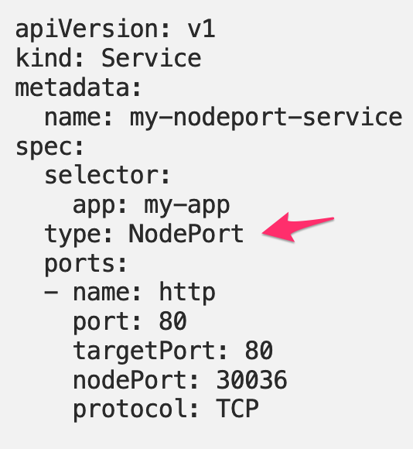
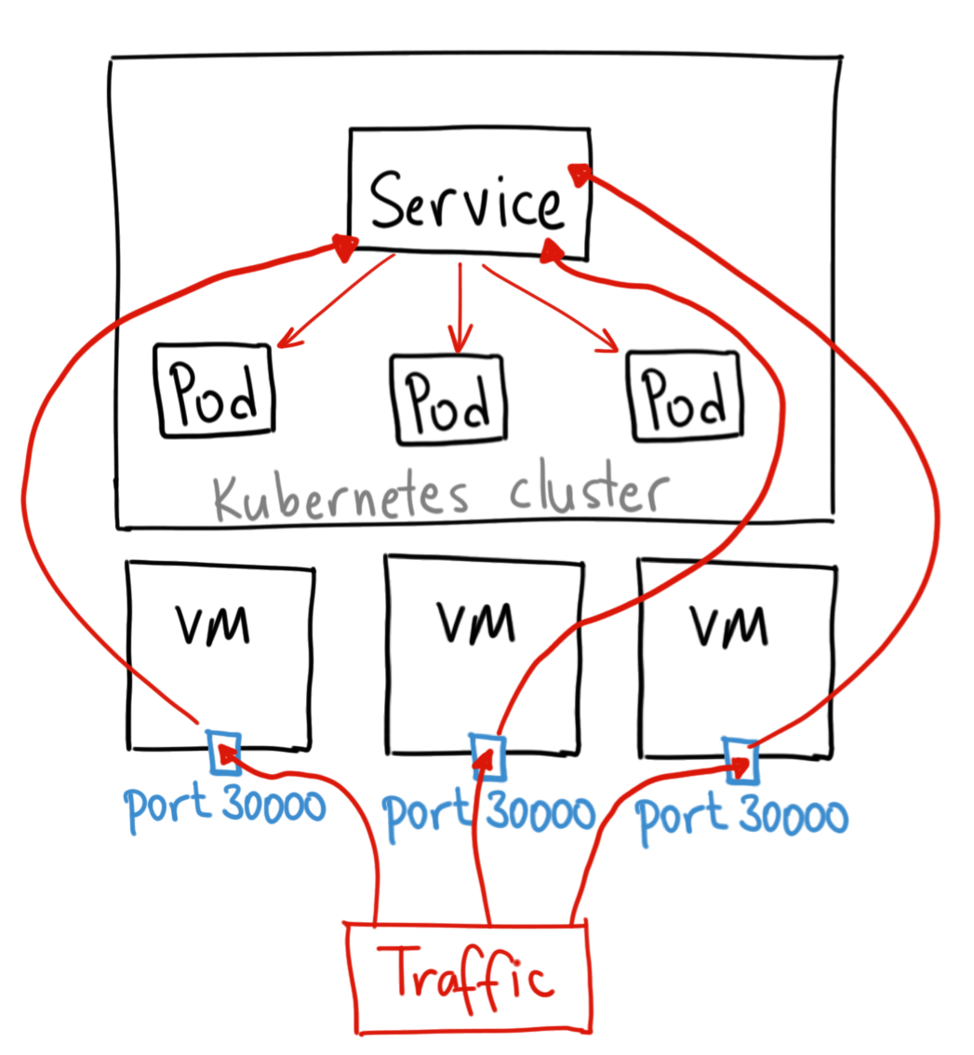
My Kubernetes (K8S) Pocket Cards
Service - NodePort
NodePort builds on top of the ClusterIP Service and provides a way to expose a group of Pods to the outside world.
$ kubectl get svc
NodePort
A NodePort service is the most primitive way to get external traffic directly to your service. NodePort, as the name implies, opens a specific port on all the Nodes (the VMs), and any traffic that is sent to this port is forwarded to the service.

Slide 77
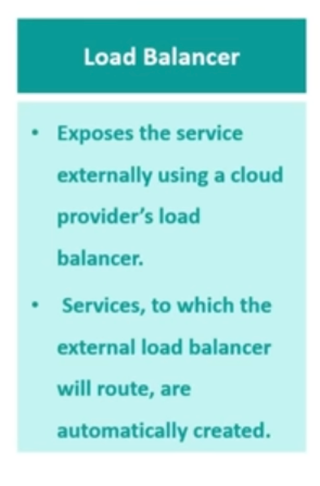
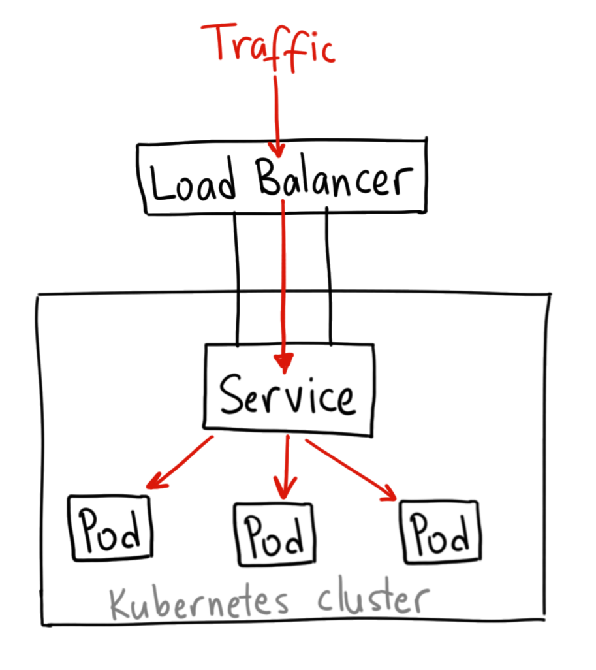
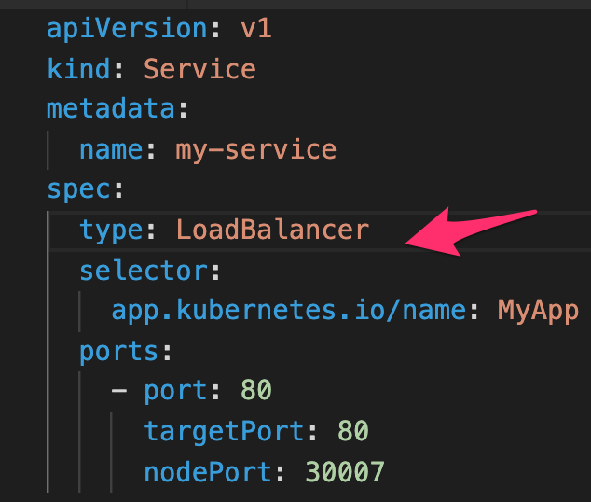
My Kubernetes (K8S) Pocket Cards
Service - LoadBalancer
A LoadBalancer service is the standard way to expose a service to the internet. On GKE, this will spin up a Network Load Balancer that will give you a single IP address that will forward all traffic to your service.
In Kubernetes clusters, a Load Balancer service performs the following tasks:
Distributing network loads and service requests efficiently across multiple instances
Enabling autoscaling in response to demand changes
Ensuring High Availability by sending workloads to healthy PODs
$ kubectl get svc
LoadBalancer type provides a Public IP address or DNS name to which the external users can connect.
Load balancers are services that distribute incoming traffic across a pool of hosts to ensure optimum workloads and high availability. Here we go in-depth on the topic.

Slide 78
My Kubernetes (K8S) Pocket Cards
How to change svc
It is very simple just change the service type.

Slide 79
My Kubernetes (K8S) Pocket Cards
How do we access multiple services using a single DNS (Domain Name Service) in K8S ?
Hello guys welcome to K8S ingress

Slide 80
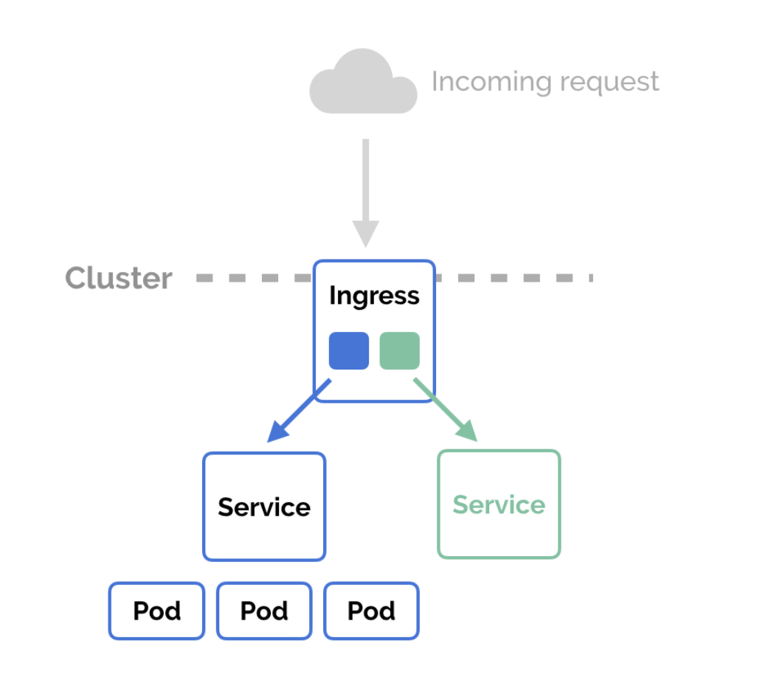
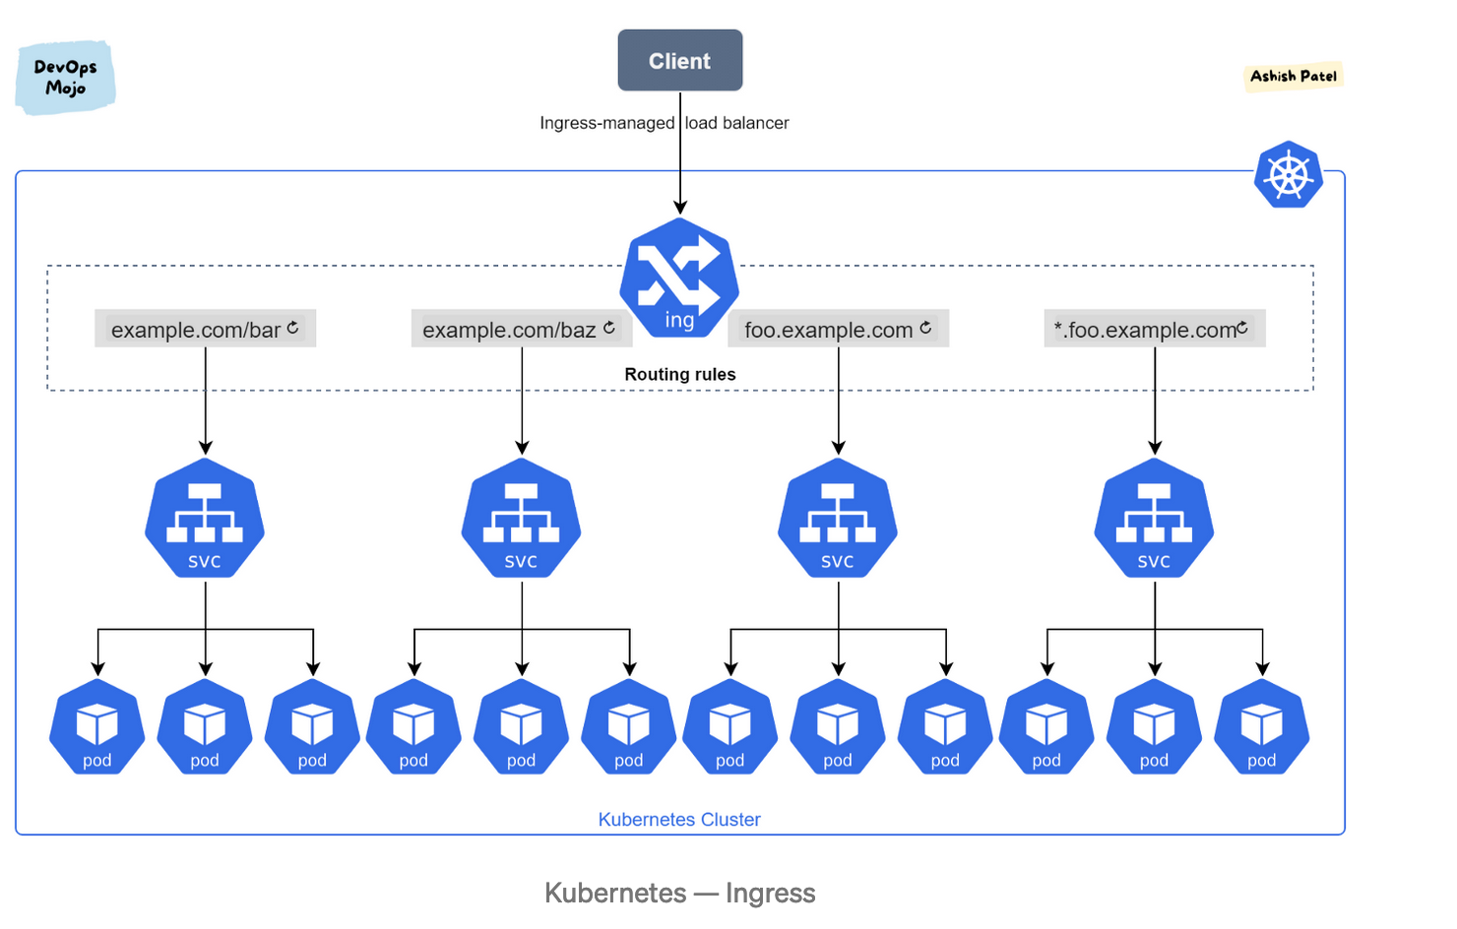
My Kubernetes (K8S) Pocket Cards
Ingress exposes HTTP and HTTPS routes from outside the cluster to services within the cluster. Traffic routing is controlled by rules defined on the Ingress resource.
Ingress
$ kubectl get ing
In Kubernetes, an Ingress is an object that allows access to your Kubernetes services from outside the Kubernetes cluster. You configure access by creating a collection of rules that define which inbound connections reach which services.

Slide 81
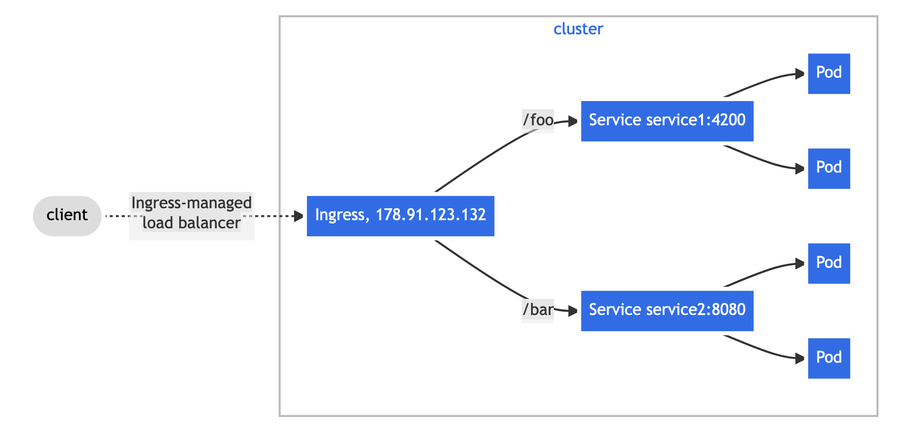
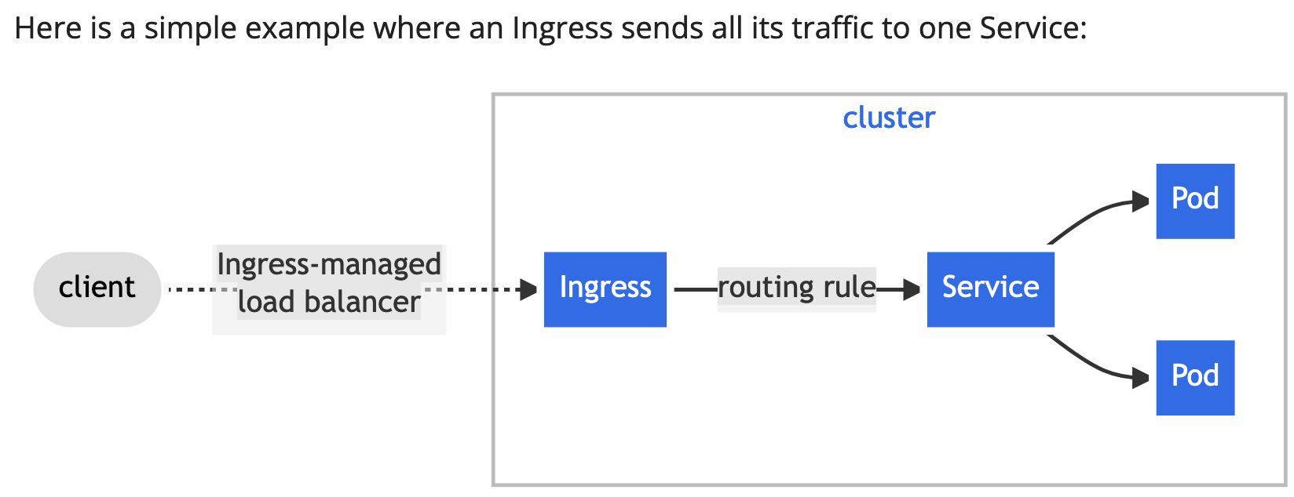
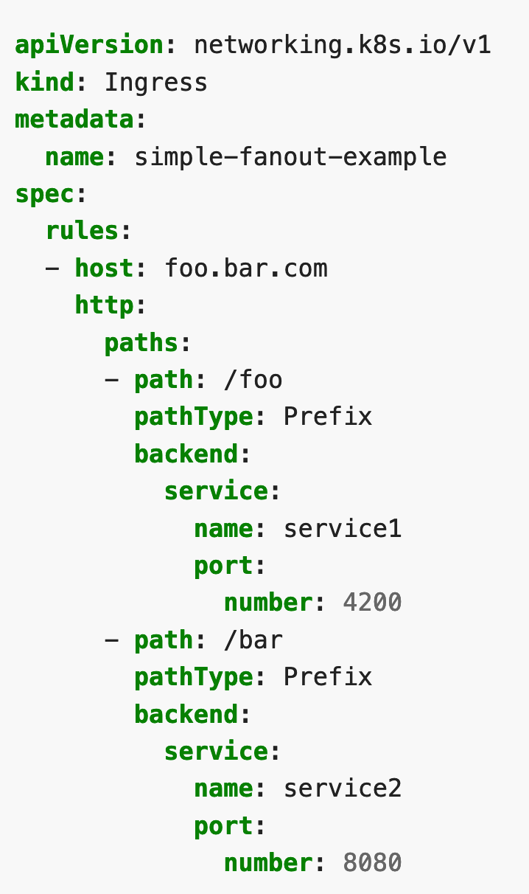
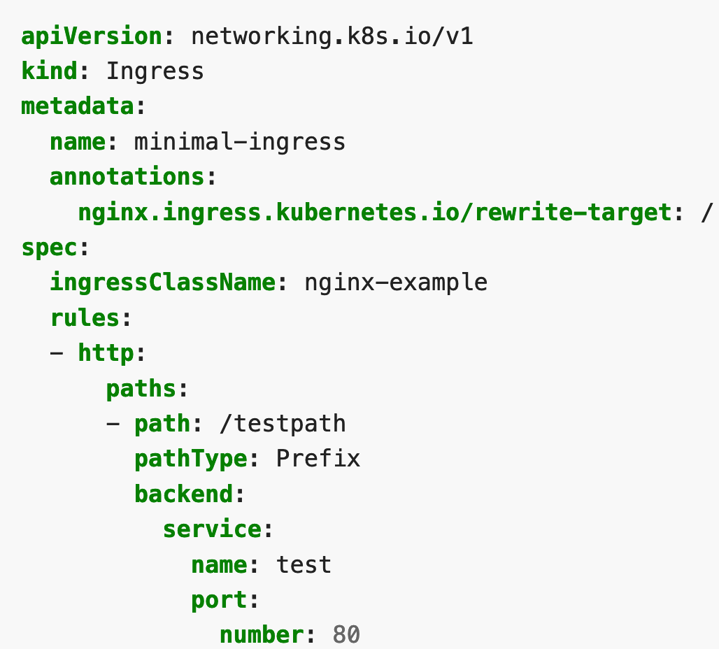
My Kubernetes (K8S) Pocket Cards
Ingress
Kubernetes Ingress is an API object that describes the routing rules for traffic (typically HTTP or HTTPS) into an application running within a Kubernetes cluster. Ingress was created to solve a routing problem in Kubernetes: an application service runs within a cluster on one or more container instances, which use virtual IP addresses for “cluster internal” communication. However, external clients that reside outside the cluster need a stable and routable IP endpoint to communicate with the service. Kubernetes Ingress was created to make this easy: it is a Kubernetes API object that maps an application to a stable, externally addressable HTTP or HTTPS URL. What an ingress controller does

Slide 82
My Kubernetes (K8S) Pocket Cards
ingress
$ kubectl get ing
an Ingress is an object that allows access to your Kubernetes services from outside the Kubernetes cluster. You configure access by creating a collection of rules that define which inbound connections reach which services.

Slide 83
My Kubernetes (K8S) Pocket Cards
How do we manage multiple application, create sub-space, sub-cluster or manage multiple customers entities in K8S ?
Hello guys welcome to K8S Namespace

Slide 84

My Kubernetes (K8S) Pocket Cards
In Kubernetes, namespaces provides a mechanism for isolating groups of resources within a single cluster
Namespace
Namespaces are Kubernetes objects which partition a single Kubernetes cluster into multiple virtual clusters. Each Kubernetes namespace provides the scope for Kubernetes Names it contains; which means that by using the combination of an object name and a Namespace, each object gets a unique identity across the cluster.
Kubernetes namespaces help different projects, teams, or customers to share a Kubernetes cluster.
$ kubectl get ns
A Kubernetes namespace helps separate a cluster into logical units. It helps granularly organize, allocate, manage, and secure cluster resources.
You can think of a Namespace as a virtual cluster inside your Kubernetes cluster. You can have multiple namespaces inside a single Kubernetes cluster, and they are all logically isolated from each other. They can help you and your teams with organization, security, and even performance!
Namespaces are a way to organize clusters into virtual sub-clusters — they can be helpful when different teams or projects share a Kubernetes cluster.
Namespaces help pod-to-pod communication using the same namespace. · Namespaces are virtual clusters that can sit on top of the same physical cluster.
A Namespace is a Kubernetes object that helps group and structure other Kubernetes objects and partitions them in a Kubernetes cluster. This concept allows you to organize or isolate your Kubernetes resources in a box-like form according to their purpose across multiple users and projects in a cluster.
Characteristics of Kubernetes Namespaces:
It provides scope for names
It has unique names for resources within but not across namespaces
It does not allow for nesting inside each other
It is used in an environment with many users spread across multiple teams and projects
A Kubernetes object can only be in one Namespace

Slide 85

My Kubernetes (K8S) Pocket Cards
Namespace
$ kubectl get ns

Slide 86
My Kubernetes (K8S) Pocket Cards
Namespace
$ kubectl get ns
Kubernetes namespace help different projects, teams, or customers to share a Kubernetes cluster.

Slide 87
My Kubernetes (K8S) Pocket Cards
Namespace
Namespaces
Application Ryann
Application Lubbock
Application Austin
Application Dallas
CLUSTER
Application Odilia
Application Canary
Application Threedent
Application Houston
Application Washington

Slide 88
My Kubernetes (K8S) Pocket Cards
How de we make sure pods are in running state a creation time in K8S ?
Hello guys welcome to K8S Livenessprobe

Slide 89

My Kubernetes (K8S) Pocket Cards
The kubelet uses liveness probes to know when to restart a container. For example, liveness probes could catch a deadlock, where an application is running, but unable to make progress. Restarting a container in such a state can help to make the application more available despite bugs.
Liveness Probe
The periodSeconds field specifies that the kubelet should perform a liveness probe every 5 seconds.
Kubernetes liveness probes determine whether your pods are running normally. Setting up these probes helps you check whether your workloads are healthy. They can identify application instances that have entered a failed state, even when the pod that contains the instance appears to be operational.
livenessProbe
Indicates whether the container is running. If the liveness probe fails, the kubelet kills the container, and the container is subjected to its restart policy. If a container does not provide a liveness probe, the default state is Success.
Liveness probes are a mechanism for indicating your application’s internal health to the Kubernetes control plane. Kubernetes uses liveness probes to detect issues within your pods. When a liveness check fails, Kubernetes restarts the container in an attempt to restore your service to an operational state.

Slide 90
My Kubernetes (K8S) Pocket Cards
Liveness Probe
livenessProbe
Indicates whether the container is running. If the liveness probe fails, the kubelet kills the container, and the container is subjected to its restart policy.
If a container does not provide a liveness probe, the default state is Success.

Slide 91
My Kubernetes (K8S) Pocket Cards
How de we make sure pods are ready to accept connection or traffic in K8S ?
Hello guys welcome to K8S Readinessprobe

Slide 92

My Kubernetes (K8S) Pocket Cards
readinessProbe
Indicates whether the container is ready to respond to requests. If the readiness probe fails, the endpoints controller removes the Pod's IP address from the endpoints of all Services that match the Pod. The default state of readiness before the initial delay is Failure. If a container does not provide a readiness probe, the default state is Success.
Readiness Probe
Readiness probes, like many management functions, are a way for you to ensure that your Kubernetes cluster is taking advantage of the features that keep your application available. Just like other systems, probes need to be designed to provide proper startup feedback within the cluster to make applications available. We will discuss using the Readiness probe in conjunction with others to provide proper application startup within a Kubernetes cluster.
The kubelet uses readiness probes to know when a container is ready to start accepting traffic.
readinessProbe: Indicates whether the container is ready to respond to requests.
Similar to other probes, it checks to ensure the container is ready to accept traffic. Unlike the liveness probe which checks to see if things remain ship-shape, the readiness probe makes sure things are in a state that traffic can start flowing.
This is at the pod level. Meaning all of the containers must be in a ready state prior to anything being passed to the service. The startup probe, while also similar, is at the application level. It would be active prior to any liveness or readiness probes.

Slide 93
My Kubernetes (K8S) Pocket Cards
Readiness Probe
readinessProbe: Indicates whether the container is ready to respond to requests.

Slide 94

My Kubernetes (K8S) Pocket Cards
Kubernetes Object: Readiness Probe vs Liveness probe
Liveness and Readiness probes are used to control the health of an application running inside a Pod’s container. Both of them are very similar in functionality, and usage.
livenessProbe: Indicates whether the container is running. · readinessProbe: Indicates whether the container is ready to respond to requests.

Slide 95
My Kubernetes (K8S) Pocket Cards
Readiness probe vs Liveness Probe
readinessProbe
Indicates whether the container is ready to respond to requests.
livenessProbe
Indicates whether the container is running.

Slide 96
My Kubernetes (K8S) Pocket Cards
How do we create a volume that our cluster can consume in K8S ?
Hello guys welcome to K8S StorageClass

Slide 97

My Kubernetes (K8S) Pocket Cards
A StorageClass provides a way for administrators to describe the "classes" of storage they offer. Different classes might map to quality-of-service levels, or to backup policies, or to arbitrary policies determined by the cluster administrators. Kubernetes itself is unopinionated about what classes represent. This concept is sometimes called "profiles" in other storage systems.
StorageClass
A Kubernetes StorageClass is a Kubernetes storage mechanism that lets you dynamically provision persistent volumes (PV) in a Kubernetes cluster. Kubernetes administrators define classes of storage, and then pods can dynamically request the specific type of storage they need.
$ kubectl get sc
Every StorageClass has the following fields:
Provisioner—this is the plugin used to provision the storage volume
Parameters—indicate properties of the underlying storage system
reclaimPolicy—indicates under what conditions the storage is released by a pod and can be reclaimed for use by other pods
A storageclass is a Kubernetes object that stores information about creating a persistent volume for your pod. With a storageclass, you do not need to create a persistent volume separately before claiming it.
A StorageClass is a Kubernetes resource that enables dynamic storage provisioning. The administrator configures the StorageClass, which can then no longer be modified. First the StorageClass is created, then the PersistentVolumeClaim and finally the Pod. When a PVC is created, Kubernetes creates a PersistentVolume and binds it to the PVC automatically, depending on the VolumeBindingMode used in the StorageClass configuration. These three Kubernetes objects are required to check the test case of a StorageClass.

Slide 98
My Kubernetes (K8S) Pocket Cards
StorageClass
$ kubectl get sc
A StorageClass is a Kubernetes object that stores information about creating a persistent volume for your pod. With a storageclass, you do not need to create a persistent volume separately before claiming it.

Slide 99
My Kubernetes (K8S) Pocket Cards
How do we provision volume for an entire application in K8S ?
Hello guys welcome to K8S PersistantVolume

Slide 100
My Kubernetes (K8S) Pocket Cards
PersistantVolume
$ kubectl get pv
A persistantVolume is a volume requested by the administrator that will be used or consumed by an application

Slide 101



My Kubernetes (K8S) Pocket Cards
A PersistentVolume (PV) is a piece of storage in the cluster that has been provisioned by an administrator or dynamically provisioned using Storage Classes.
PersistentVolume
$ kubectl get pv
A Persistent Volume is a piece of storage available to the cluster.
Kubernetes persistent volumes remain available outside of the pod lifecycle – this means that the volume will remain even after the pod is deleted.
Persistent volume (PV) is a piece of storage provided by an administrator in a Kubernetes cluster. When a developer needs persistent storage for an application in the cluster, they request that storage by creating a persistent volume claim (PVC) and then mounting the volume to a path in the pod. Once that is done, the pod claims any volume that matches its requirements (such as size, access mode, and so on). An administrator can create multiple PVs with different capacities and configurations. It is up to the developer to provide a PVC for storage, and then Kubernetes matches a suitable PV with the PVC. If there is no PV to match the PVC, the StorageClass dynamically creates a PV and binds it to the PVC.

Slide 102

My Kubernetes (K8S) Pocket Cards
Kubernetes Object: PersistentVolume access mode
Access Modes
A PersistentVolume can be mounted on a host in any way supported by the resource provider. As shown in the table below, providers will have different capabilities and each PV's access modes are set to the specific modes supported by that particular volume. For example, NFS can support multiple read/write clients, but a specific NFS PV might be exported on the server as read-only. Each PV gets its own set of access modes describing that specific PV's capabilities.
The access modes are:
$ kubectl get pv

Slide 103
My Kubernetes (K8S) Pocket Cards
How do we provision volume for a specific pod in K8S ?
Hello guys welcome to K8S PersistantVolumeClaim

Slide 104


My Kubernetes (K8S) Pocket Cards
PersistentVolumeClaim
A persistent volume claim (PVC) is a request for storage, which is met by binding the PVC to a persistent volume (PV).
A PersistentVolumeClaim is a request for and claim to a PersistentVolume resource. PersistentVolumeClaim objects request a specific size, access mode, and StorageClass for the PersistentVolume. If a PersistentVolume that satisfies the request exists or can be provisioned, the PersistentVolumeClaim is bound to that PersistentVolume.
$ kubectl get pvc
Pods consume node resources and PVCs consume PV resources.
A PersistentVolumeClaim (PVC) is a request for storage by a user. It is similar to a Pod.
Persistent volume claim is a request for storage usage by a Kubernetes developer.
A PersistentVolumeClaim is a request for and claim to a PersistentVolume resource.

Slide 105
My Kubernetes (K8S) Pocket Cards
PersistantVolumeClaim
$ kubectl get pvc
A persistantVolume is a volume a pod specific pod will consume or use

Slide 106
My Kubernetes (K8S) Pocket Cards
PersistentVolume vs PersistentVolumeClaim
Short and Simple
Persistent Volume - Available storage let's say you have 100Gi
Persistent Volume Claim - You request from Persistent Volume, let's say you request 10Gi you'll get it but if you request 110Gi you won't get it
$ kubectl get pvc,pv
So a persistent volume (PV) is the "physical" volume on the host machine that stores your persistent data. A persistent volume claim (PVC) is a request for the platform to create a PV for you, and you attach PVs to your pods via a PVC.
A PersistentVolume (PV) is a piece of storage in the cluster that has been provisioned by server/storage/cluster administrator or dynamically provisioned using Storage Classes. It is a resource in the cluster just like node.
A PersistentVolumeClaim (PVC) is a request for storage by a user which can be attained from PV. It is similar to a Pod. Pods consume node resources and PVCs consume PV resources. Pods can request specific levels of resources (CPU and Memory). Claims can request specific size and access modes (e.g., they can be mounted ReadWriteOnce, ReadOnlyMany or ReadWriteMany.
A PersistentVolume (PV) is a piece of storage in the cluster or central storage let's say 100GB.
A PersistentVolumeClaim (PVC) is a request for storage by a user for the application to use 10GB.
In real life scenario, PV is whole cake and PVC is piece of cake (But you can have a whole cake if there are no other people to eat (just like if there are no other application to use you can use whole PV )).

Slide 107
My Kubernetes (K8S) Pocket Cards
PersistentVolume vs PersistentVolumeClaim
$ kubectl get pvc,pv
A Persistent Volume Claim is telling you what options you have access to in a particular cluster and they got this circular at this store called Smart Tech with some ads about your configuration options, those ads are the Persistent Volume Claim.
Inside your config file you write out the different Persistent Volume Claims that you are going to have inside your cluster, kind of like your wish list to Santa, but of course you are going to go take that to the sales guy at Smart Tech when you are done.
So you write a config file that says there should a 600gb hard drive option available to all your clusters and a 1TB hard drive option as well.
When you choose one of these options of the Persistent Volume Claim you go and request that Kubernetes (the sales guy) goes and gets that option for you, the option you have chosen, Kubernetes has to look through these instances of storage options in the stock room that are readily available. These instances of hard drives can be used right away and they are considered statically provisioned because they are created ahead of time.
On the other hand, there is dynamically provisioned options that were created on the fly, when you asked Kubernetes the sales guy, so kind of like just-in-time production, it got created when you immediately asked for it.
So the Persistent Volume Claim is the stores advertisement of options and whichever one you choose Kubernetes will go get it, either one in storage or create one on the fly.
The Persistent Volume is the actual product or options that you get back from Kubernetes that you asked for. If Kubernetes does not have what you asked for it will try to create it on the fly for you.
So the PVC is what Smart Tech is advertising they have to offer to your cluster which Kubernetes the sales guy will get for you and the PV is the actual finished product delivered to you.

Slide 108

My Kubernetes (K8S) Pocket Cards
StorageClass, PersistentVolume PersistentVolumeClaim
$ kubectl get sc,pvc,pv

Slide 109
My Kubernetes (K8S) Pocket Cards
How do we manage volumes in K8S ?
Hello guys welcome to K8S volumes management in K8S

Slide 110
My Kubernetes (K8S) Pocket Cards
StorageClass
PV (5Gi)
PV (10Gi)
PV (15Gi)
pvc (1Gi)
pvc (10Gi)
pvc (3Gi)
pvc (1Gi)
pvc (7Gi)
pvc (1Gi)
pvc (1Gi)
pvc (0.8Gi)
Application: Canary
pvc (2Gi)
Application: Odilia
Application: Thomosis

Slide 111
My Kubernetes (K8S) Pocket Cards
Storageclass get it volume from cloud provider and is the volume consume on the entire cluster
PersistantVolume get it volume from StorageClass and is the volume that will be consumed by an application
PersistentVolumeClaim get it volume from PersistantVolume and is the volume that will be consumed by a specific pod

Slide 112

My Kubernetes (K8S) Pocket Cards
This is a storageclass

Slide 113

My Kubernetes (K8S) Pocket Cards
This is a storageclass

Slide 114

My Kubernetes (K8S) Pocket Cards
This is a storageclass

Slide 115
My Kubernetes (K8S) Pocket Cards
How do we create a file or directory in a node and use it as volume in K8S ?
Hello guys welcome to K8S Volume: Hostpath

Slide 116
My Kubernetes (K8S) Pocket Cards
How do we manage non sensitive, non important volume in others words do we manage volume we dont care losing in K8S ?
Hello guys welcome to K8S Volume: Hostpath and EmptyDir

Slide 117

My Kubernetes (K8S) Pocket Cards
Hostpath
A hostPath volume mounts a file or directory from the host node's filesystem into your Pod. This is not something that most Pods will need, but it offers a powerful escape hatch for some applications.
hostPath type volumes refer to directories on the Node (VM/machine) where your Pod is scheduled for running (aks-nodepool1-39499429-1 in this case). So you'd need to create this directory at least on that Node.
A hostPath volume points to a specific file or directory

Slide 118
My Kubernetes (K8S) Pocket Cards
Hostpath
This volume will be lost if the node die
A hostPath volume mounts a file or directory from the host node filesystem into your Pod.

Slide 119
My Kubernetes (K8S) Pocket Cards
How do we create volume inside pod only in K8S ?
Hello guys welcome to K8S Volume: EmptyDir

Slide 120

My Kubernetes (K8S) Pocket Cards
EmptyDir
emptyDir
An emptyDir volume is first created when a Pod is assigned to a node, and exists as long as that Pod is running on that node. As the name says, the emptyDir volume is initially empty. All containers in the Pod can read and write the same files in the emptyDir volume, though that volume can be mounted at the same or different paths in each container. When a Pod is removed from a node for any reason, the data in the emptyDir is deleted permanently.
emptyDir are volumes that get created empty when a Pod is created.
An emptyDir volume is especially useful for sharing files between containers running in the same pod.
An emptyDir volume is first created when a Pod is assigned to a Node, and exists as long as that Pod is running on that node. As the name says, it is initially empty.

Slide 121
My Kubernetes (K8S) Pocket Cards
EmptyDir
This volume will be lost if the pod die
emptyDir are volumes that get created empty when a Pod is created.
An emptyDir volume is especially useful for sharing files between containers running in the same pod.

Slide 122
My Kubernetes (K8S) Pocket Cards
Hostpath vs EmptyDir
Hostpath volume is the volume mounted on the node where the EmptyDir volume is the volume mounted on pod
If the pod die the EmptyDir volume will be deleted
If the node die the hostpath volume will be deleted

Slide 123
My Kubernetes (K8S) Pocket Cards
Hostpath vs EmptyDir
A hostPath volume mounts a file or directory from the host node filesystem into your Pod.
EmptyDir are volumes that get created empty when a Pod is created.

Slide 124
My Kubernetes (K8S) Pocket Cards
How do we Deploy pods in K8S ?
Hello guys welcome to K8S Deployment

Slide 125

My Kubernetes (K8S) Pocket Cards
Deployment
A Deployment is a Kubernetes resource object used for declarative application updates. Deployments allow you to define the lifecycle of applications, including the container images they use, the number of pods and the manner of updating them.
Deployments are fully managed by the backend in Kubernetes, with the entire update process being server side, with no client involvement. They ensure that a specified number of pods are always running and available. The entire update process is recorded, with versioning to provide options for pausing, resuming or rolling back to previous versions.
$ kubectl get deploy
A Deployment runs multiple replicas of your application and automatically replaces any instances that fail or become unresponsive.
A deployment is an object in Kubernetes that lets you manage a set of identical pods.
In Kubernetes, the smallest unit of deployment is not a container; it's a pod.
You describe a desired state in a Deployment, and the Deployment Controller changes the actual state to the desired state at a controlled rate. You can define Deployments to create new ReplicaSets, or to remove existing Deployments and adopt all their resources with new Deployments.
A Kubernetes Deployment is used to tell Kubernetes how to create or modify instances of the pods that hold a containerized application.
A Kubernetes deployment is a resource object in Kubernetes that provides declarative updates to applications.

Slide 126
My Kubernetes (K8S) Pocket Cards
Deployment
This help to create or give birth to k8s pods
A Kubernetes Deployment tells Kubernetes how to create or modify instances of the pods that hold a containerized application.

Slide 127
My Kubernetes (K8S) Pocket Cards
How do we Deploy stateful application (pods) in K8S ?
Hello guys welcome to K8S Statefulset

Slide 128
My Kubernetes (K8S) Pocket Cards
Stateful application
Stateful applications save data to persistent disk storage for use by the server, by clients, and by other applications. An example of a stateful application is a database or key-value store to which data is saved and retrieved by other applications.
A stateful app is a program that saves client data from the activities of one session for use in the next session.
A Stateful application remembers specific details of a user like profile, preferences, and user actions.
Stateful applications are typically databases

Slide 129
My Kubernetes (K8S) Pocket Cards
StatefulSet
$ kubectl get sts
Like a Deployment, a StatefulSet manages Pods that are based on an identical container spec. Unlike a Deployment, a StatefulSet maintains a sticky identity for each of their Pods. These pods are created from the same spec, but are not interchangeable: each has a persistent identifier that it maintains across any rescheduling.
Manages the deployment and scaling of a set of Pods, and provides guarantees about the ordering and uniqueness of these Pods.
A StatefulSet is a workload API object for managing stateful applications. Usually, Kubernetes users are not concerned with how pods are scheduled, although they do require pods to be deployed in order, to be attached to persistent storage volumes, and to have unique, persistent network IDs that are retained through rescheduling. StatefulSets can help achieve these objectives.
Like Deployments, StatefulSets manage the pods based on the same container specifications. However, they differ from deployments in that they maintain sticky identities for each pod. Pods may be created from an identical spec, but they are not interchangeable and are thus assigned unique identifiers that persist through rescheduling.
StatefulSet is the workload API object used to manage stateful applications.

Slide 130
My Kubernetes (K8S) Pocket Cards
Statefulset
This help to create or give birth to k8s pods
Two commonly used ones are Deployments and StatefulSets.
A Deployment manages multiple pods by automating the creation, updating, and deletion of ReplicaSets.
By contrast, a StatefulSet helps orchestrate stateful pods by guaranteeing the ordering and uniqueness of pod replicas.

Slide 131
My Kubernetes (K8S) Pocket Cards
StatefulSet vs Deployment
Deployment
Deployments allow you to manage sets of identical pods (or ReplicaSets) using common configurations. Once you’ve defined and deployed a Deployment, Kubernetes ensures that the pods it manages meet the requirements you’ve set. This provides granular control over the rollout of new pod versions and rollback to previous versions.
Deployments are typically used for stateless applications, but you can save a deployment’s state by attaching a persistent volume and making it stateful. All deployed pods share the same volume, with the same data.
The controller verifies if the current state matches the deployment’s desired set, and creates a ReplicaSet if necessary, which then creates the pods. The major components of a deployment are the deployment template, the persistent volumes and the service.
Related content: read our guide to Kubernetes Persistent Volumes
StatefulSets
In a StatefulSet, each pod is given a name and treated individually, in contrast to a Kubernetes Deployment, where pods are easily replaceable. Stateful applications require pods with unique identities. This means that if any pod dies, it is immediately noticeable.
Every pod in a StatefulSet has two unique, stable identities (a network ID and a storage ID). The network ID enables the pod’s DNS name to persist across rescheduling (although the IP addresses may still change). The storage ID is retained regardless of the node the storage instance is rescheduled on. Persistent storage is required to enable the application to save the state and data across restarts.
StatefulSets serve as controllers, but they don’t create ReplicaSets—they create uniquely named pods, according to a specified pattern. The DNS name of a pod includes the ordinal index.
Each replica in a StatefulSet has its own state, with a unique persistent volume claim (PVC) created for each pod. For example, a StatefulSet with four replicas creates four pods, which each have their own volume, amounting to four PVCs.
StatefulSets require a headless service to return the IPs of the associated pods and enable direct interaction with them. The headless service has a service IP but no IP address and has to be created separately.
The major components of a StatefulSet are the set itself, the persistent volume and the headless service.
Key Differences
Here are the main differences between Deployments and StatefulSets:
Deployments are used for stateless applications, StatefulSets for stateful applications
The pods in a deployment are interchangeable, whereas the pods in a StatefulSet are not.
Deployments require a service to enable interaction with pods, while a headless service handles the pods’ network ID in StatefulSets.
In a deployment, the replicas all share a volume and PVC, while in a StatefulSet each pod has its own volume and PVC.

Slide 132

My Kubernetes (K8S) Pocket Cards
StatefulSet vs Deployment
A Kubernetes Deployment is a resource object in Kubernetes that provides declarative updates to applications. A deployment allows us to describe an application’s life cycle. Such as, which images to use for the app, the number of pods there should be, and how they should be updated.
A StatefulSets are more suited for stateful apps. A stateful application requires pods with a unique identity (for instance, hostname). A pod will be able to reach other pods with well-defined names. It needs a Headless Service to connect with the pods. A Headless Service does not have an IP address. Internally, it creates the necessary endpoints to expose pods with DNS names.
The StatefulSet definition includes a reference to the Headless Service, but we have to create it separately. StatefulSet needs persistent storage so that the hosted application saves its state and data across restarts. Once the StatefulSet and the Headless Service are created, a pod can access another one by name prefixed with the service name.

Slide 133
My Kubernetes (K8S) Pocket Cards
StatefulSet vs Deployment
Kubernetes Deployment and Kubernetes StatefulSet are two powerful resources for managing containerized applications on Kubernetes. Deployments are useful for managing stateless applications, while StatefulSets are useful for managing stateful applications that require stable network identities and persistent storage.
Deployments and ReplicationControllers are meant for stateless usage and are rather lightweight. StatefulSets are used when state has to be persisted. Therefore the latter use volumeClaimTemplates / claims on persistent volumes to ensure they can keep the state across component restarts.
So if your application is stateful or if you want to deploy stateful storage on top of Kubernetes use a StatefulSet.
If your application is stateless or if state can be built up from backend-systems during the start then use Deployments.

Slide 134
My Kubernetes (K8S) Pocket Cards
Statefulset vs deployment
Two commonly used ones are Deployments and StatefulSets.
A Deployment manages multiple pods by automating the creation, updating, and deletion of ReplicaSets.
By contrast, a StatefulSet helps orchestrate stateful pods by guaranteeing the ordering and uniqueness of pod replicas.
A Kubernetes Deployment tells Kubernetes how to create or modify instances of the pods that hold a containerized application.
A DaemonSet
ensures that all Nodes run a copy of a Pod.

Slide 135
My Kubernetes (K8S) Pocket Cards
StatefulSet vs Deployment vs Daemonset
Two commonly used ones are Deployments and StatefulSets.
A Deployment manages multiple pods by automating the creation, updating, and deletion of ReplicaSets.
By contrast, a StatefulSet helps orchestrate stateful pods by guaranteeing the ordering and uniqueness of pod replicas.
A Kubernetes Deployment tells Kubernetes how to create or modify instances of the pods that hold a containerized application.
A DaemonSet
ensures that all Nodes run a copy of a Pod.

Slide 136
My Kubernetes (K8S) Pocket Cards
How do we manage volume in K8S ?
Hello guys welcome to K8S volumes

Slide 137

My Kubernetes (K8S) Pocket Cards
Deployment is a resource to deploy a stateless application, if using a PVC, all replicas will be using the same Volume and none of it will have its own state.

Slide 138

My Kubernetes (K8S) Pocket Cards
Statefulsets is used for Stateful applications, each replica of the pod will have its own state, and will be using its own Volume.

Slide 139

My Kubernetes (K8S) Pocket Cards
DaemonSet is a controller similar to ReplicaSet that ensures that the pod runs on all the nodes of the cluster. If a node is added/removed from a cluster, DaemonSet automatically adds/deletes the pod.

Slide 140
My Kubernetes (K8S) Pocket Cards
How do we give an identity to pod to talk with API server in K8S ?
Hello guys welcome to K8S Service account

Slide 141
My Kubernetes (K8S) Pocket Cards
ServiceAccount
A ServiceAccount provides an identity for processes that run in a Pod.
A process inside a Pod can use the identity of its associated service account to authenticate to the cluster's API server.
User accounts are for humans. Service accounts are for application processes, which (for Kubernetes) run in containers that are part of pods.

Slide 142

My Kubernetes (K8S) Pocket Cards
ServiceAccount

Slide 143
My Kubernetes (K8S) Pocket Cards
ServiceAccount
Every Namespace in K8S has a service account attached to it
For security reasons each pod should have its own ServiceAccount

Slide 144
My Kubernetes (K8S) Pocket Cards
How do we manage ports in K8S ?
Hello guys welcome to K8S Service: Port

Slide 145

My Kubernetes (K8S) Pocket Cards
Port in K8S
nodePort
This setting makes the service visible outside the Kubernetes cluster by the node’s IP address and the port number declared in this property. The service also has to be of type NodePort (if this field isn’t specified, Kubernetes will allocate a node port automatically).
port
Expose the service on the specified port internally within the cluster. That is, the service becomes visible on this port, and will send requests made to this port to the pods selected by the service.
targetPort
This is the port on the pod that the request gets sent to. Your application needs to be listening for network requests on this port for the service to work.
targetPort and containerPort basically refer to the same port (so if both are used they are expected to have the same value) but they are used in two different contexts and have entirely different purposes.
They cannot be used interchangeably as both are part of the specification of two distinct kubernetes resources/objects: Service and Pod respectively. While the purpose of containerPort can be treated as purely informational, targetPort is required by the Service which exposes a set of Pods.
It's important to understand that by declaring containerPort with the specific value in your Pod/Deployment specification you cannot make your Pod to expose this specific port e.g. if you declare in containerPort field that your nginx Pod exposes port 8080 instead of default 80, you still need to configure your nginx server in your container to listen on this port.
Declaring containerPort in Pod specification is optional. Even without it your Service will know where to direct the request based on the info it has declared in its targetPort.
It's good to remember that it's not required to declare targetPort in the Service definition. If you omit it, it defaults to the value you declared for port (which is the port of the Service itself).

Slide 146

My Kubernetes (K8S) Pocket Cards
Port in K8S

Slide 147

My Kubernetes (K8S) Pocket Cards
Port in K8S
Node
NodePort
Service
Port
pod
targetPort

Slide 148
My Kubernetes (K8S) Pocket Cards
Port in K8S
nodePort:
The port on the node where external traffic will come in on
Port:
The port of this service
targetPort:
The target port on the pod(s) to forward traffic to

Slide 149
My Kubernetes (K8S) Pocket Cards
Port in K8S
Traffic comes in on
nodePort
forwards to
Port:
on the service which then routes to
on the pod(s)
targetPort

Slide 150
My Kubernetes (K8S) Pocket Cards
What is the small element in K8S ?
Hello guys welcome to K8S pod

Slide 151


My Kubernetes (K8S) Pocket Cards
Pod
A pod is the smallest execution unit in Kubernetes.
$ kubectl get po
A Pod (as in a pod of whales or pea pod) is a group of one or more containers, with shared storage and network resources, and a specification for how to run the containers.
Pods are the smallest deployable units of computing that you can create and manage in Kubernetes.
A pod encapsulates one or more applications.
A pod is a group of one or more containers. A container is an enclosed, self-contained execution process, much like a process in an operating system. Kubernetes uses pods to run your code and images in the cluster.
Kubernetes works with Pods, rather than containers, so that containers in the same pod can be guaranteed to run on the same machine. Containers in the same pod share their networking infrastructure, storage resources, and lifecycle.
A Kubernetes pod is a collection of one or more Linux containers, and is the smallest unit of a Kubernetes application.

Slide 152

My Kubernetes (K8S) Pocket Cards
Pod

Slide 153
My Kubernetes (K8S) Pocket Cards
Pod
Pods are the smallest deployable units of computing that you can create and manage in Kubernetes.

Slide 154
My Kubernetes (K8S) Pocket Cards
How do we make sure we don’t accidently delete a pod in K8S ?
Hello guys welcome to K8S Pod disruption budget

Slide 155

My Kubernetes (K8S) Pocket Cards
A Pod Disruption Budget (PDB) allows you to limit the disruption to your application when its pods need to be rescheduled for some reason such as upgrades or routine maintenance work on the Kubernetes nodes.
Poddisruptionbudget
$ kubectl get pdb
A pdb defines the budget of voluntary disruption. In essence, a human operator is letting the cluster aware of a minimum threshold in terms of available pods that the cluster needs to guarantee in order to ensure a baseline availability or performance. The word budget is used as in error budget, in the sense that any voluntary disruption within this budget should be acceptable
PodDisruptionBudget (pdb) is a useful layer of defence provided by Kubernetes to deal with this kind of issue.

Slide 156
My Kubernetes (K8S) Pocket Cards
Pod
PodDisruptionBudget
Allow user not to accidentally delete a pod

Slide 157
My Kubernetes (K8S) Pocket Cards
How do we control pod scheduling in K8S ?
Hello guys welcome to K8S Pod affinity/anti-affinity

Slide 158

My Kubernetes (K8S) Pocket Cards
Pod affinity/anti-affinity
Pod affinity/anti-affinity allows you to constrain which nodes your pod is eligible to be scheduled on based on the labels on other pods.
Pod anti affinity is a group of inter pod anti affinity scheduling rules.

Slide 159


My Kubernetes (K8S) Pocket Cards
Pod affinity/anti-affinity

Slide 160

My Kubernetes (K8S) Pocket Cards
Nodeselector
nodeSelector is the simplest recommended form of node selection constraint.
This is a simple Pod scheduling feature that allows scheduling a Pod onto a node whose labels match the nodeSelector labels specified by the user.
nodeSelector is the early Kubernetes feature designed for manual Pod scheduling.
nodeSelector is one of the forms of node selection constraint.

Slide 161
My Kubernetes (K8S) Pocket Cards
Pod affinity/anti-affinity
Pod affinity and pod anti-affinity allow you to constrain which nodes your pod is eligible to be scheduled on based on the key/value labels on other pods.

Slide 162
My Kubernetes (K8S) Pocket Cards
How to manage pod autoscaling in K8S ?
Hello guys welcome to K8S Horizontal Pod Autoscaler

Slide 163
My Kubernetes (K8S) Pocket Cards
Horizontal Pod Autoscaler
$ kubectl get hpa
The Horizontal Pod Autoscaler changes the shape of your Kubernetes workload by automatically increasing or decreasing the number of Pods in response to the workload's CPU or memory consumption, or in response to custom metrics reported from within Kubernetes or external metrics from sources outside of your cluster.
The Kubernetes Horizontal Pod Autoscaler automatically scales the number of pods in a deployment, replication controller, or replica set based on that resource's CPU utilization.
Horizontal scaling means that the response to increased load is to deploy more Pods.
This is different from vertical scaling, which for Kubernetes would mean assigning more resources (for example: memory or CPU) to the Pods that are already running for the workload.
Horizontal Pod Autoscaler (HPA):adjusts the number of replicas of an application.

Slide 164


My Kubernetes (K8S) Pocket Cards
Horizontal Pod Autoscaler

Slide 165

My Kubernetes (K8S) Pocket Cards
Horizontal Pod Autoscaler

Slide 166


My Kubernetes (K8S) Pocket Cards
Horizontal Pod Autoscaler

Slide 167
My Kubernetes (K8S) Pocket Cards
Horizontal Pod Autoscaler
Horizontal Pod Autoscaler:
adjusts the number of replicas of an application

Slide 168
My Kubernetes (K8S) Pocket Cards
What are pods phase in K8S ?
Hello guys welcome to K8S Pod phase in k8s

Slide 169

My Kubernetes (K8S) Pocket Cards
Pod phase
Pending:
The Pod has been accepted by the Kubernetes cluster, but one or more of the containers has not been set up and made ready to run. This includes time a Pod spends waiting to be scheduled as well as the time spent downloading container images over the network.
Running:
The Pod has been bound to a node, and all of the containers have been created. At least one container is still running, or is in the process of starting or restarting.
Succeeded: All containers in the Pod have terminated in success, and will not be restarted.
Failed:
All containers in the Pod have terminated, and at least one container has terminated in failure. That is, the container either exited with non-zero status or was terminated by the system.
Unknown:
For some reason the state of the Pod could not be obtained. This phase typically occurs due to an error in communicating with the node where the Pod should be running.

Slide 170

My Kubernetes (K8S) Pocket Cards
Pod phase

Slide 171
My Kubernetes (K8S) Pocket Cards
Pod phase
Running
Pending
Unknown
Succeeded
Failed

Slide 172
My Kubernetes (K8S) Pocket Cards
What are containers state in K8S ?
Hello guys welcome to K8S Container state in k8s

Slide 173
My Kubernetes (K8S) Pocket Cards
Container State
Waiting
If a container is not in either the Running or Terminated state, it is Waiting. A container in the Waiting state is still running the operations it requires in order to complete start up: for example, pulling the container image from a container image registry, or applying Secret data. When you use kubectl to query a Pod with a container that is Waiting, you also see a Reason field to summarize why the container is in that state.
Terminated
A container in the Terminated state began execution and then either ran to completion or failed for some reason. When you use kubectl to query a Pod with a container that is Terminated, you see a reason, an exit code, and the start and finish time for that container's period of execution.
If a container has a preStop hook configured, this hook runs before the container enters the Terminated state
Running
The Running status indicates that a container is executing without issues. If there was a postStart hook configured, it has already executed and finished. When you use kubectl to query a Pod with a container that is Running, you also see information about when the container entered the Running state

Slide 174

My Kubernetes (K8S) Pocket Cards
Container State

Slide 175

My Kubernetes (K8S) Pocket Cards
Pod phase
Waiting
Running
Terminated

Slide 176
My Kubernetes (K8S) Pocket Cards
What are pod condition in K8S ?
Hello guys welcome to K8S pod condition in k8s

Slide 177

My Kubernetes (K8S) Pocket Cards
Pod Condition

Slide 178
My Kubernetes (K8S) Pocket Cards
Pod condition
ContainersReady
PodScheduled
Ready
Initialized

Slide 179
My Kubernetes (K8S) Pocket Cards
How to manage Permission in K8S ?
Hello guys welcome to K8S Permission

Slide 180
My Kubernetes (K8S) Pocket Cards
How do we create rules in K8S ?
Hello guys welcome to K8S roles

Slide 181

My Kubernetes (K8S) Pocket Cards
Role
$ kubectl get role
ClusterRoles and Roles define the actions a user can perform within a namespace
A Role always sets permissions within a particular namespace; when you create a Role, you have to specify the namespace it belongs in.

Slide 182
My Kubernetes (K8S) Pocket Cards
Role
A Role always sets permissions within a particular namespace

Slide 183
My Kubernetes (K8S) Pocket Cards
How do we grant role on a user or group of users in K8S ?
Hello guys welcome to K8S rolebinding

Slide 184

My Kubernetes (K8S) Pocket Cards
RoleBinding
$ kubectl get rb
A RoleBinding grants the permissions defined in a Role to a User, Service Account or Group.
A rolebinding grants the permissions defined in a role to a user or set of users

Slide 185
My Kubernetes (K8S) Pocket Cards
Role
A rolebinding grants the permissions defined in a role to a user or set of users

Slide 186
My Kubernetes (K8S) Pocket Cards
How do we grant role on a user or group of users in K8S ?
Hello guys welcome to K8S Clusterrole

Slide 187
My Kubernetes (K8S) Pocket Cards
ClusterRole
$ kubectl get cr
A cluster role for Kubernetes defines user permissions required to perform operations on a Kubernetes cluster.
ClusterRole, by contrast, is a non-namespaced resource. The resources have different names (Role and ClusterRole) because a Kubernetes object always has to be either namespaced or not namespaced; it can't be both.
ClusterRoles and Roles define the actions a user can perform within a cluster
A ClusterRole can be used to grant the same permissions as a Role.

Slide 188
My Kubernetes (K8S) Pocket Cards
clusterRole
A cluster role for Kubernetes defines user permissions required to perform operations on a Kubernetes cluster.

Slide 189
My Kubernetes (K8S) Pocket Cards
How do we grant permissions across a whole cluster in K8S ?
Hello guys welcome to K8S ClusterroleBinding

Slide 190

My Kubernetes (K8S) Pocket Cards
ClusterRoleBinding
$ kubectl get crb
To grant permissions across a whole cluster, you can use a ClusterRoleBinding.
ClusterRoleBinding grants that access cluster-wide.

Slide 191
My Kubernetes (K8S) Pocket Cards
clusterRoleBinding
To grant permissions across a whole cluster, you can use a

Slide 192

My Kubernetes (K8S) Pocket Cards
Permission

Slide 193

My Kubernetes (K8S) Pocket Cards
Permission

Slide 194

My Kubernetes (K8S) Pocket Cards
Permission

Slide 195

My Kubernetes (K8S) Pocket Cards
Permission

Slide 196
My Kubernetes (K8S) Pocket Cards
Permission
Role
RoleBinding
ClusterRole
ClusterRoleBinding

Slide 197
My Kubernetes (K8S) Pocket Cards
How do we make sure a container or some containers run to completion before others can start running in K8S ?
Hello guys welcome to K8S Init Container(s)

Slide 198

My Kubernetes (K8S) Pocket Cards
Init Containers
An init container is a type of container that has a few modified operational behavior and rules.
Init Containers are the containers that should run and complete before the startup of the main container in the pod.
Init Containers run before App containers
Init containers can contain utilities or setup scripts not present in an app image.
We can have and run multiple Init Containers before App Container.
Init containers are exactly like regular containers, except:
Init containers always run to completion.
Each init container must complete successfully before the next one starts.
If a Pod's init container fails, Kubernetes repeatedly restarts the Pod until the init container succeeds.
Init containers are exactly like regular containers, except: Init containers always run to completion.

Slide 199
My Kubernetes (K8S) Pocket Cards
Init Containers
init containers:
specialized containers that run before app containers in a Pod.

Slide 200


My Kubernetes (K8S) Pocket Cards
Init Containers

Slide 201
My Kubernetes (K8S) Pocket Cards
What files are being used to deploy K8S ressource ?
Hello guys welcome to K8S manifest file

Slide 202
My Kubernetes (K8S) Pocket Cards
K8S manifest
A manifest specifies the desired state of an object that Kubernetes will maintain when you apply the manifest. Each configuration file can contain multiple manifests.
When you are going to deploy to kubernetes , or create a kubernetes resources like a pod , replica-set , configmap , secret , deployment , etc , you need to write a file called manifest that describe that object and its attributes either in yaml or json.
A Kubernetes Manifest files are the heart of Kubernetes. These plaintext configuration files describe how a pod’s containers should be run and connected to other objects, such as services or replication controllers.
The manifest is a specification of a Kubernetes API object in JSON or YAML format. A manifest specifies the desired state of an object that Kubernetes will maintain when you apply the manifest.

Slide 203

My Kubernetes (K8S) Pocket Cards
K8S manifest

Slide 204
My Kubernetes (K8S) Pocket Cards
K8S manifest
apiVersion
Kind
Metadata
Spec

Slide 205

My Kubernetes (K8S) Pocket Cards
K8S manifest

Slide 206
My Kubernetes (K8S) Pocket Cards
How do we limit memory and cpu pod(s) can use ?
Hello guys welcome to K8S resource utilisation

Slide 207



My Kubernetes (K8S) Pocket Cards
Pod Ressource

Slide 208
My Kubernetes (K8S) Pocket Cards
How do we manage volume in K8S ?
Hello guys welcome to K8S Volume

Slide 209

My Kubernetes (K8S) Pocket Cards
VolumeMount
This is the path in the container on which the mounting will take place.

Slide 210

My Kubernetes (K8S) Pocket Cards
Volume
A Kubernetes volume is a directory containing data, which can be accessed by containers in a Kubernetes pod.

Slide 211
My Kubernetes (K8S) Pocket Cards
How do we manage Image in K8S ?
Hello guys welcome to K8S
image pull management

Slide 212


My Kubernetes (K8S) Pocket Cards
ImagepullPolicy

Slide 213
My Kubernetes (K8S) Pocket Cards
Imagepullpolicy
Always
Kubernetes will always pull the image from the Repository.
IfNotPresent
Kubernetes will only pull the image when it does not already exist on the node.
Never
Kubernetes will never pull the image.

Slide 214
My Kubernetes (K8S) Pocket Cards
How do we make sure pod dont get schedule on particular node in K8S ?
Hello guys welcome to K8S
Taint

Slide 215
My Kubernetes (K8S) Pocket Cards
Taint
By best practise never deploy a pod on a master
By default kubernetes master in TAINT

Slide 216
My Kubernetes (K8S) Pocket Cards
Taint
Taints are a property of nodes that push pods away if they are not tolerate to node taint.
Taints are a Kubernetes node property that enable nodes to repel certain pods.
Taints and tolerations are a mechanism that allows you to ensure that pods are not placed on inappropriate nodes.
taints are a property of nodes that push pods away if they don't tolerate this taint.
A taint allows a node to refuse pod to be scheduled unless that pod has a matching toleration.

Slide 217
My Kubernetes (K8S) Pocket Cards
How do we Mark node as unschedulable. in K8S ?
Hello guys welcome to K8S
Cordon

Slide 218
My Kubernetes (K8S) Pocket Cards
cordon
Kubernetes cordon is an operation that marks or taints a node in your existing node pool as unschedulable
kubectl has a command called cordon, which allows us to make a node unschedulable

Slide 219
My Kubernetes (K8S) Pocket Cards
How do we mark the node as unschedulable and also evict pods on the node. in K8S ?
Hello guys welcome to K8S
drain

Slide 220
My Kubernetes (K8S) Pocket Cards
cordon
The given node will be marked unschedulable to prevent new pods from arriving. 'drain' evicts the pods. Otherwise, it will use normal DELETE to delete the pods. The 'drain' evicts or deletes all pods except mirror pods (which cannot be deleted through the API server).

Slide 221
My Kubernetes (K8S) Pocket Cards
Pods failure in K8S
Hello guys welcome to K8S
Pod failure

Slide 222
My Kubernetes (K8S) Pocket Cards
Pod Failure errors
The main cause of CreateContainerConfigError is either a secret or ConfigMap that’s referenced in your pod, but doesn’t exist.
CreateContainerConfigError and CreateContainerError are two errors that occur when a Kubernetes tries to create a container in a pod, but fails before the container enters the Running state.
CrashLoopBackOff is a common error in Kubernetes, indicating a pod constantly crashing in an endless loop.
ImagePullBackOff means that a Pod couldn't start, because Kubernetes couldn't pull a container image.

Slide 223
My Kubernetes (K8S) Pocket Cards
Commands in K8S
Hello guys welcome to K8S
Kubectl commands

Slide 224

My Kubernetes (K8S) Pocket Cards
Commands

Slide 225
My Kubernetes (K8S) Pocket Cards
Commands
Show Merged kubeconfig settings.
kubectl config view

Slide 226
My Kubernetes (K8S) Pocket Cards
Commands
Creating Object .
kubectl apply -f [ manifest file]
Kubectl apply -f deployment.yml

Slide 227

My Kubernetes (K8S) Pocket Cards
Commands
List Object .
Kubectl get [ Object name]

Slide 228

My Kubernetes (K8S) Pocket Cards
Commands
Get the yaml file of Object .
Kubectl get [ Object] [object name ] -oyaml

Slide 229

My Kubernetes (K8S) Pocket Cards
Commands
Check on which node the object was deployed .
Kubectl get [ Object name] -owide

Slide 230

My Kubernetes (K8S) Pocket Cards
Commands
List Object by namespace .
Kubectl -n [namespace] get [ Object name]

Slide 231

My Kubernetes (K8S) Pocket Cards
Commands
Delete objects .
Kubectl delete [object] [ Object name]

Slide 232

My Kubernetes (K8S) Pocket Cards
Commands
Describe objects —---- important troubleshooting command
Kubectl describe [object] [ Object name]

Slide 233

My Kubernetes (K8S) Pocket Cards
Commands
Scaling ressources
Kubectl scale [object ] [ Object name] -- replicas=[number of replicas desired]
kubectl scale deploy test --replicas=5

Slide 234

My Kubernetes (K8S) Pocket Cards
Commands
Get the logs of a pod
Kubectl logs [pod name]

Slide 235
My Kubernetes (K8S) Pocket Cards
Commands
Copy files and directories to and from containers

Slide 236

My Kubernetes (K8S) Pocket Cards
Commands
Interacting with Nodes and cluster

Slide 237
My Kubernetes (K8S) Pocket Cards
Troubleshooting in K8S
Hello guys welcome to K8S
Troubleshooting

Slide 238

My Kubernetes (K8S) Pocket Cards
Troubleshooting a pod

Slide 239
My Kubernetes (K8S) Pocket Cards
Deployment type in K8S
Hello guys welcome to K8S
Deployment strategies

Slide 240

My Kubernetes (K8S) Pocket Cards
Deployment strategy

Slide 241

My Kubernetes (K8S) Pocket Cards
Deployment strategy: Recreation
Recreation

Slide 242



My Kubernetes (K8S) Pocket Cards
Deployment strategy: Rolling Update

Slide 243

My Kubernetes (K8S) Pocket Cards
Deployment strategy: Blue/green
Blue/green

Slide 244



My Kubernetes (K8S) Pocket Cards
Deployment strategy: Canary
Canary

Slide 245
My Kubernetes (K8S) Pocket Cards
Deployment Strategy
Recreation
Blue/green
Canary

Slide 246
My Kubernetes (K8S) Pocket Cards
What is service mesh in k8s
Hello guys welcome to K8S Istio

Slide 247
My Kubernetes (K8S) Pocket Cards
Service mesh

Slide 248
My Kubernetes (K8S) Pocket Cards
istio

Slide 249
My Kubernetes (K8S) Pocket Cards
How do you define privileges for individual pods or containers ?
Hello guys welcome to K8S SecurityContext

